Slide 1
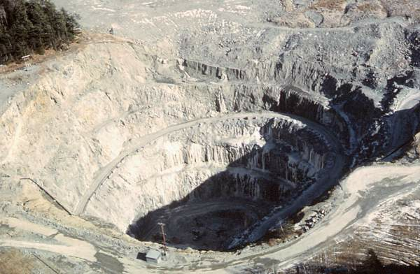
DEP’s new mining rules: will they stop another Callahan?
Callahan Mine, Brooksville

Slide 2
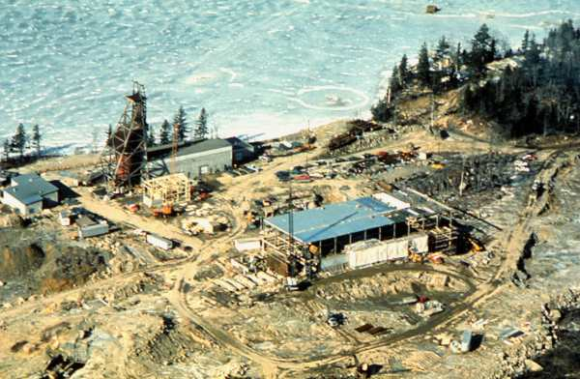
Kerr American Mine, Blue Hill

Slide 3
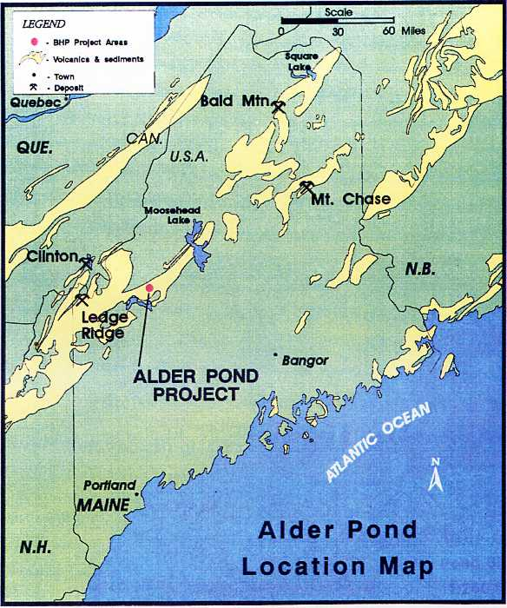

Slide 4
Summitville Mine, CO

Slide 5
Beal Mountain Mine, MT

Slide 7
Landusky Mine after reclamation, 2005

Slide 8
Acid mine drainage in Swift Gulch, 2004

Slide 9
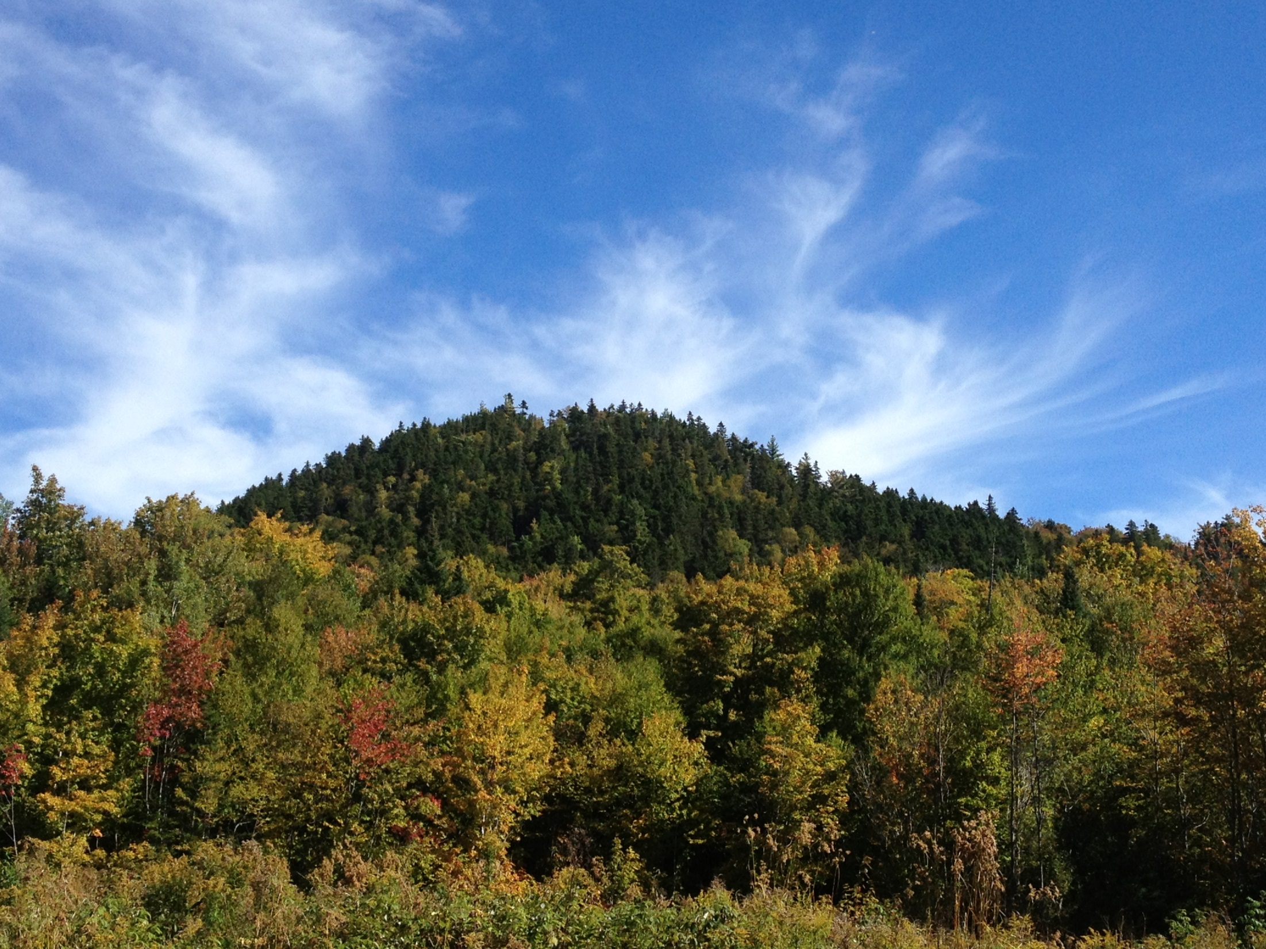
Bald Mountain, Aroostook County, ME

Slide 10
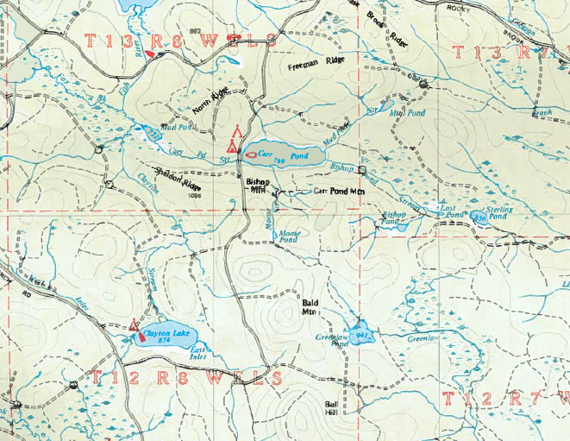

Slide 11
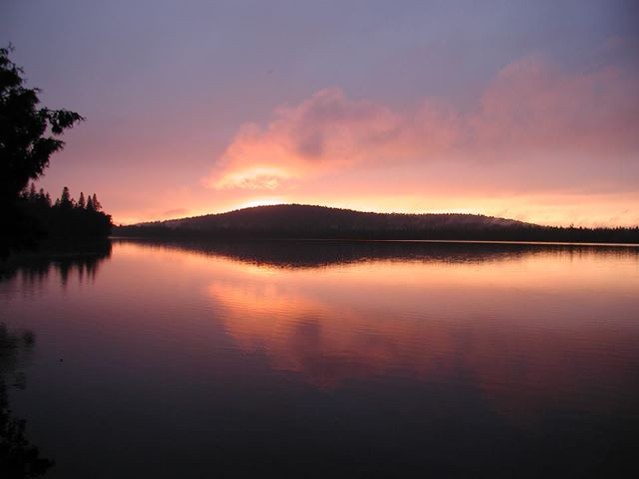
Carr Pond at Sunset

Slide 12
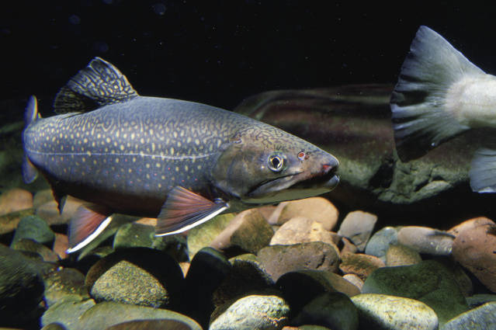
Brook trout, US Fish and Wildlife Service photo

Slide 13
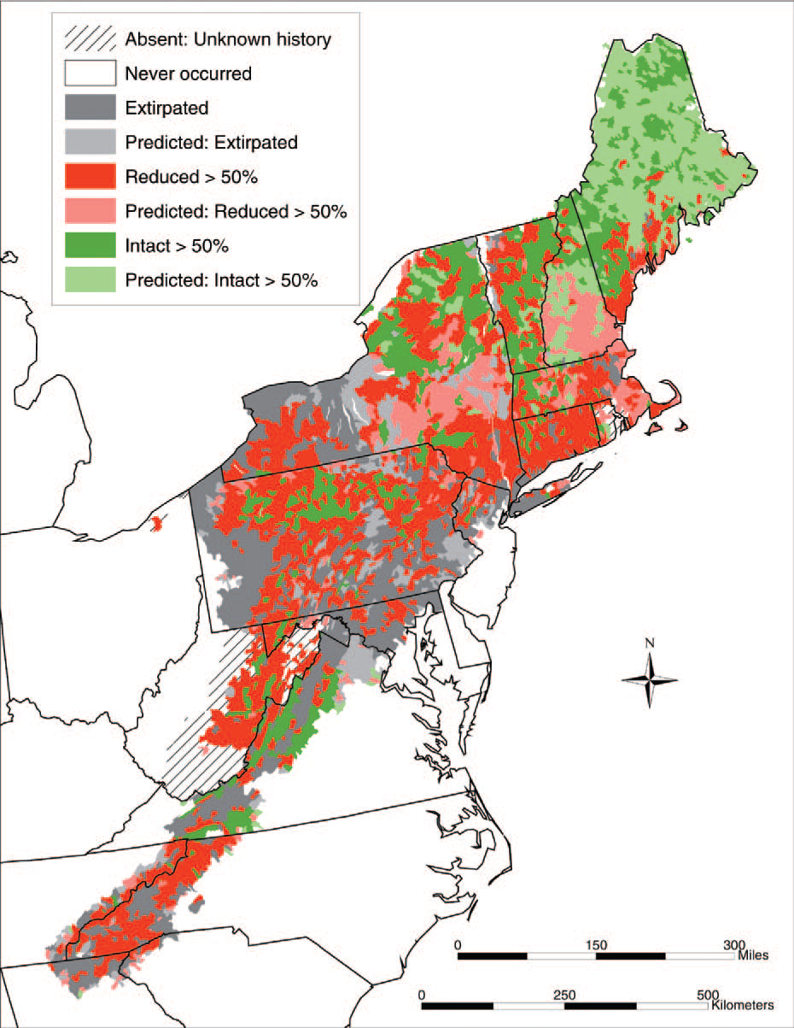

Slide 14
Key Provisions to improve Rules
Only approve mine designed to complete wastewater treatment within 10 years after closure
Pay all financial assurance up front
Have the same groundwater requirements as Maine’s solid waste rules
Protection from fugitive emissions

Slide 15

www.nrcm.org

Slide 16
