Slide 1
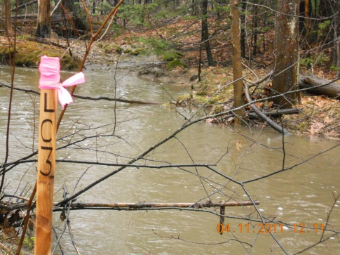
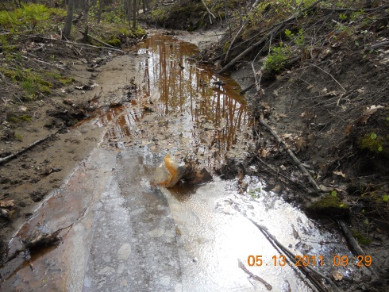
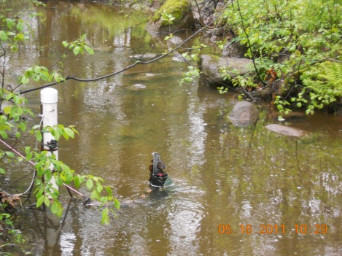

2010 – 2011 Long Creek Update
October 20, 2011
Presented by
Tamara Lee Pinard
LCWMD Executive Director
CCSWCD Stormwater Program Manager

Slide 2
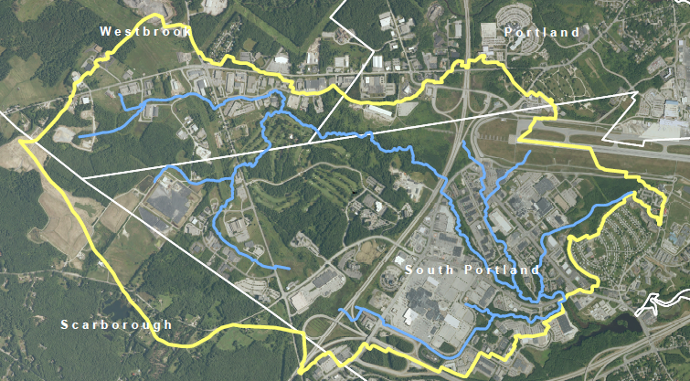

Colonel Westbrook Business Park
Jetport
Sable Oaks Golf Course
Maine Mall

Slide 3
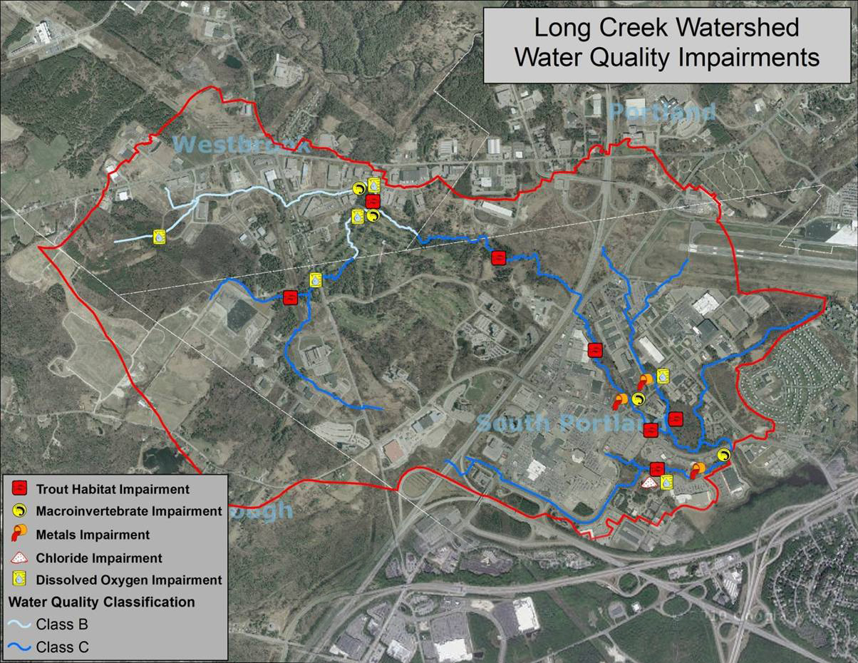
What is the big picture problem?
Long Creek and its tributaries
do not meet
state water quality standards

Slide 4
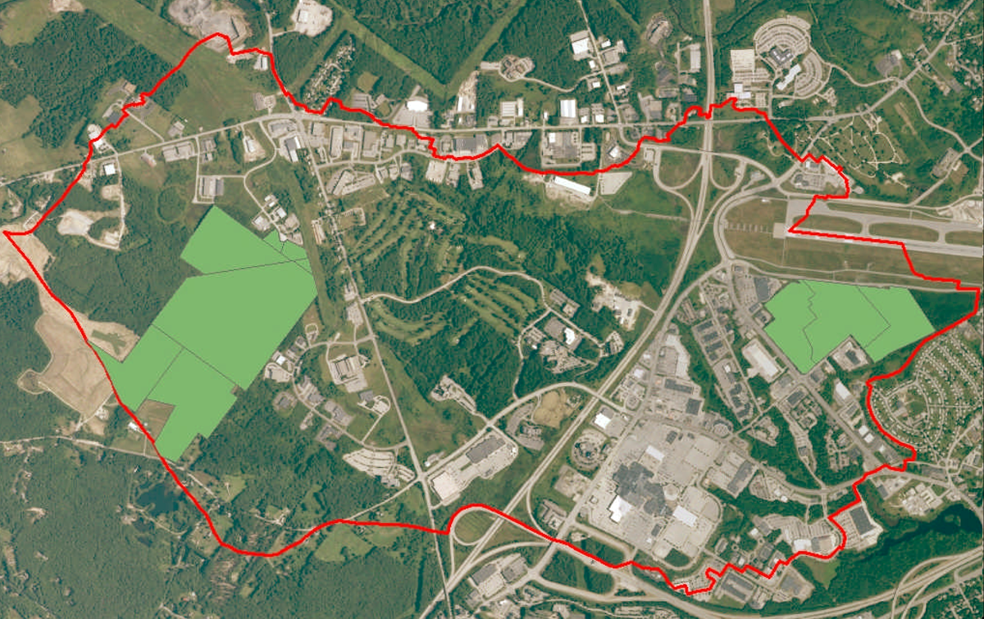
Previously Regulated Parcels
Notes:
640 acres of impervious surface in the watershed
Approximately 560 acres are designated
RDA Requirements
Maine DEP to administer program
Requires permits for discharges from parcels with at least 1 acre of impervious cover
Owners of designated parcels need a permit
Two options exist:
Individual permit
General permit

Slide 5
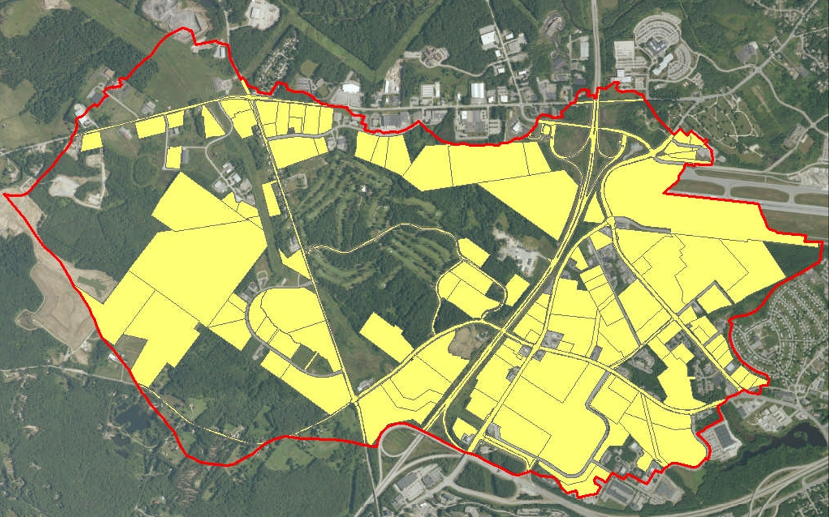
Now Regulated Under
Long Creek General Permit
Notes:
640 acres of impervious surface in the watershed
Approximately 560 acres are designated
RDA Requirements
Maine DEP to administer program
Requires permits for discharges from parcels with at least 1 acre of impervious cover
Owners of designated parcels need a permit
Two options exist:
Individual permit
General permit

Slide 6
Residual Designation Authority
Conservation Law Foundation petitioned EPA in March of 2008.
EPA preliminary decision to designate published in Federal Register on 12/31/08
Final decision published 10/30/09
Notes:
Section 402 (p) of the Clean Water Act

Slide 7
RDA Requirements
Requires permits for discharges from property with at least 1 acre of impervious surface
Maine DEP to administer permitting program
Owners of designated parcels need a permit
  Two options exist:
    Individual permit
    General permit

Slide 8

Striking a Balance
$11,410
Collaboration allows all contributors to pool resources and solve collective problem
Certain projects will require collective action
Stormwater treatment systems for individual parcels less efficient than those for multiple parcels
$3,000
General
Permit
Fee per
Impervious
Acre
Individual
Permit
Costs per
Impervious
Acre
Notes:
Cost effective
Estimate that collective solution will cost ~1/3 what a landowner by landowner approach would cost
How?
Fund priority actions, not all actions;
Collaborative projects like stream restoration are only possible as part of a collective solution
Fund cost-effective options before less cost-effective ones

Slide 9
Legal Structure
Established through interlocal agreement between four watershed municipalities
Allows for public and private board members who will oversee plan implementation
Westbrook
Portland
South Portland
Scarborough

Slide 10

Creating an Agreement that Meets the Needs of Private Businesses and Public Entities
Doors into and out of the Watershed Program
Assuring participation will
be valued
Predictability of fees
Fairness: everyone –
public and private – needed
to be signing the same agreement
Notes:
Assuring participation will be valued
Addressing the concern that landowners with redevelopment plans feel they may “pay twice”
Complexity of landowners – differing structures re: landowner, leasee, etc.

Slide 11
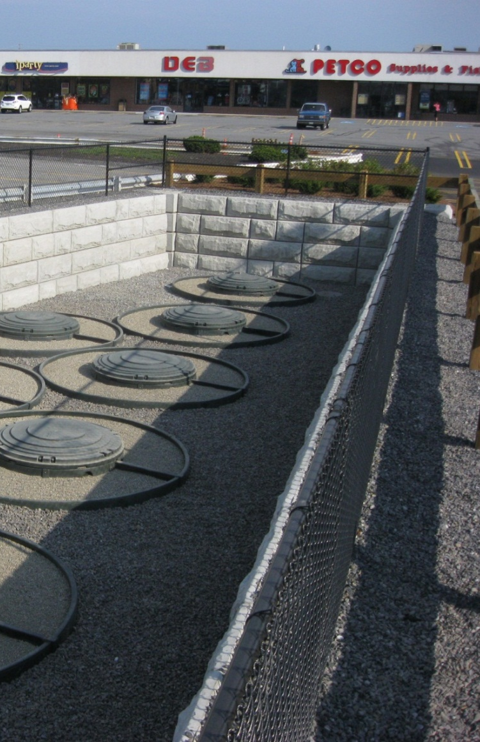
Landowner Obligations
Pay Assessments on time
Provide Easement on Private Land for Public Purpose
Coordinate with Management District for Pollution Prevention Good Housekeeping Activities
Change legalities to logistics
Notes:
Easements on private property needed to address:
Potential to redevelop property and either remove or relocate the installed BMP and associated easement
Liability of the landowner

Slide 12
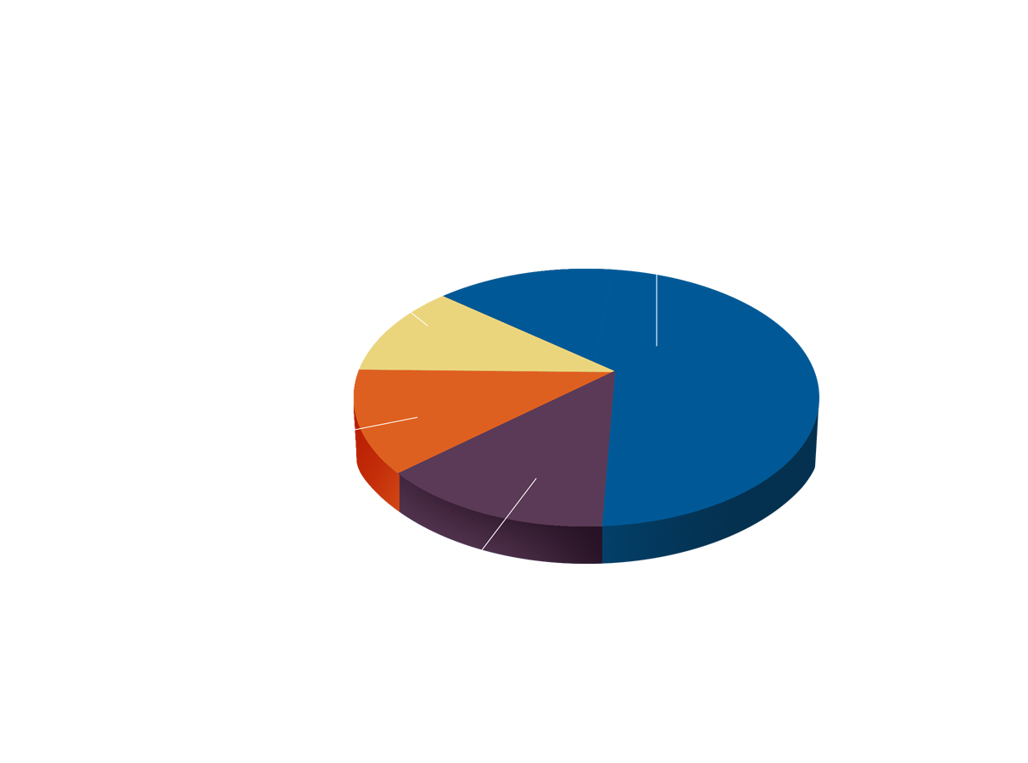
Assessment Structure
$3,000/impervious acre/year
Credits provided for stormwater treatment and good housekeeping activities on own parcel

Slide 13

Biggest Surprises
Risks taken by CCSWCD, DEP and other partners
Negotiation for the Interlocal and Participating Landowner Agreements
Ease of signing up general permit participants

Slide 14
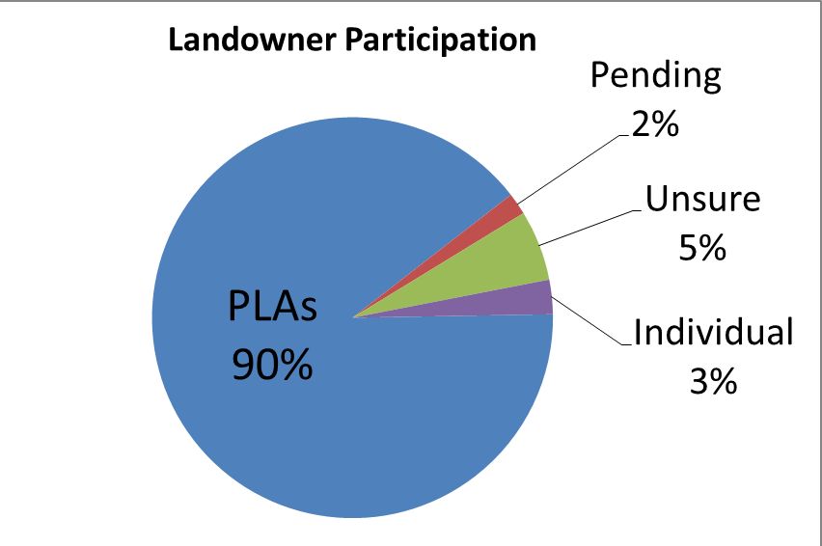
Markers of Success

Slide 15
Goal: Meet Water Quality Standards by 2020
Treat 150 impervious acres
  26.33 acres treated (18%)
Implement stream habitat mitigation
  2 out of 10 sites completed
Implement non-structural measures
  Good housekeeping – in progress
  Targeted education – in progress
Notes:
Non-structural BMPs:
Land use planning and standards promoting LID
Good housekeeping
Targeted education and training to promote adoption of previous two components
Operation and Maintenance plans have been developed for all participating parcels

Slide 16
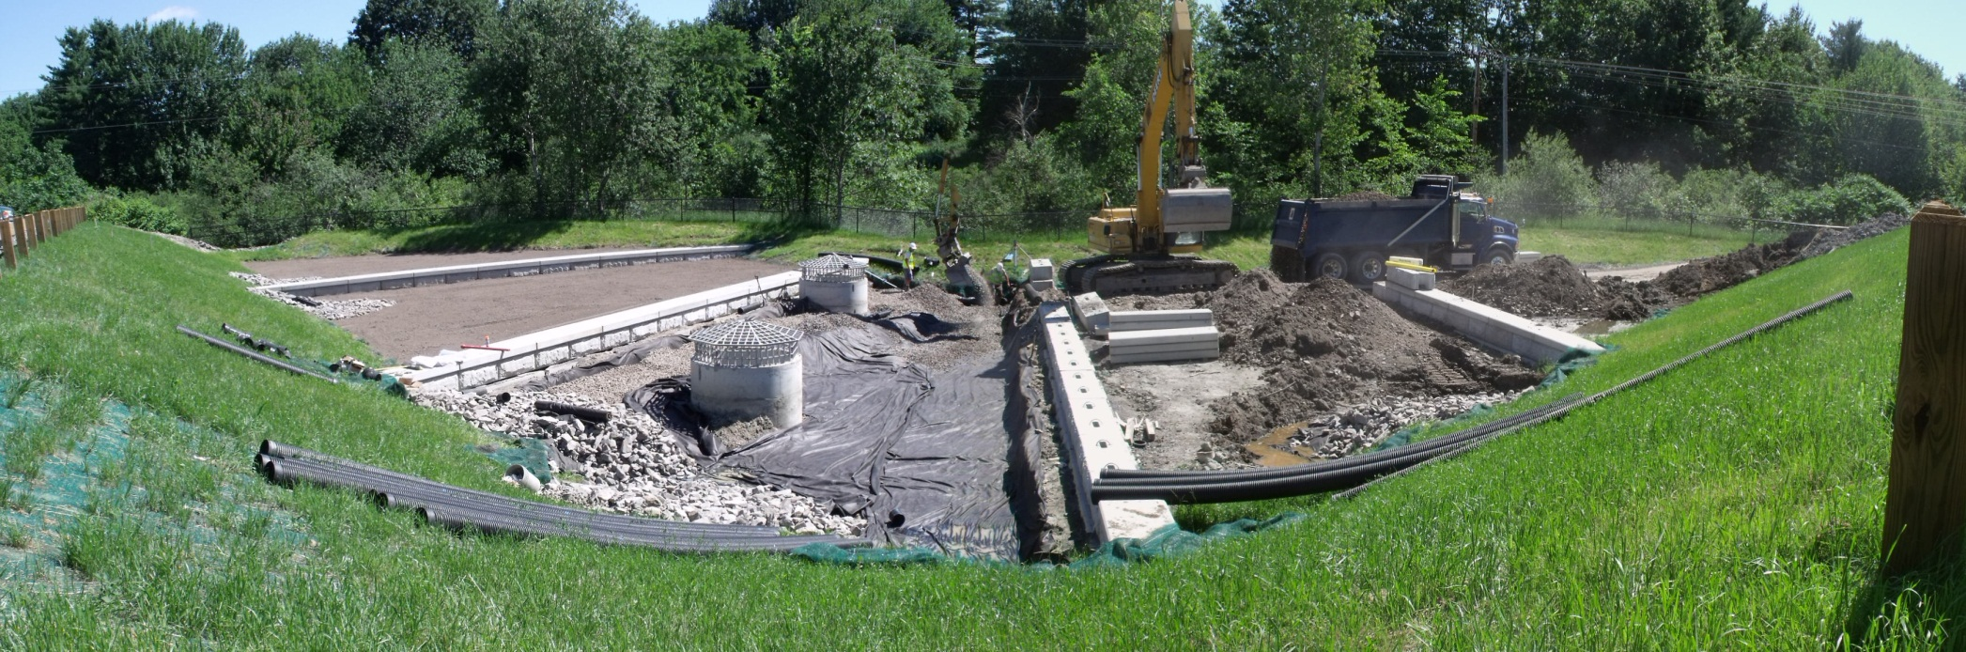
Mall Plaza Phase I Priority Retrofit
Site Characteristics Project Cost
Impervious Cover: Engineering & Oversight: $ 99,471
Rooftop - 25% (3.4 acres) Construction: $ 578,959
Parking - 75% (10.4 acres) Legal & Administration: $ 22,388
Total $ 700,818
Impervious Cover Treated: 11 acres
Under Construction

Slide 17
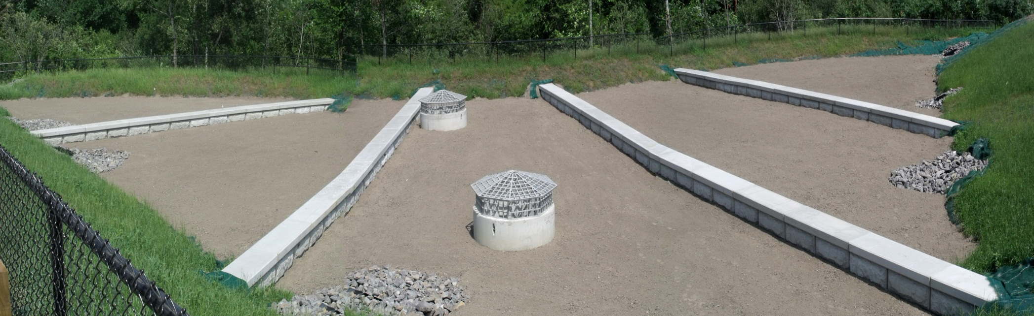
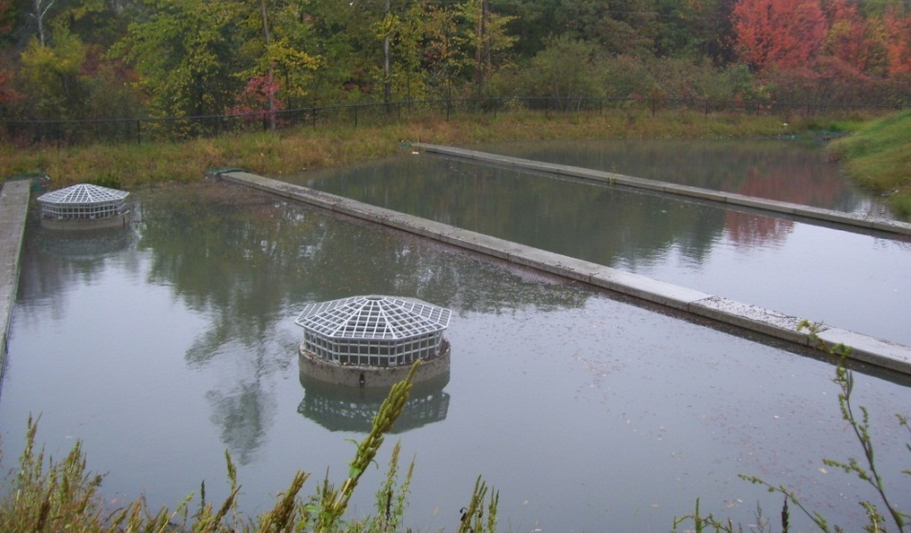
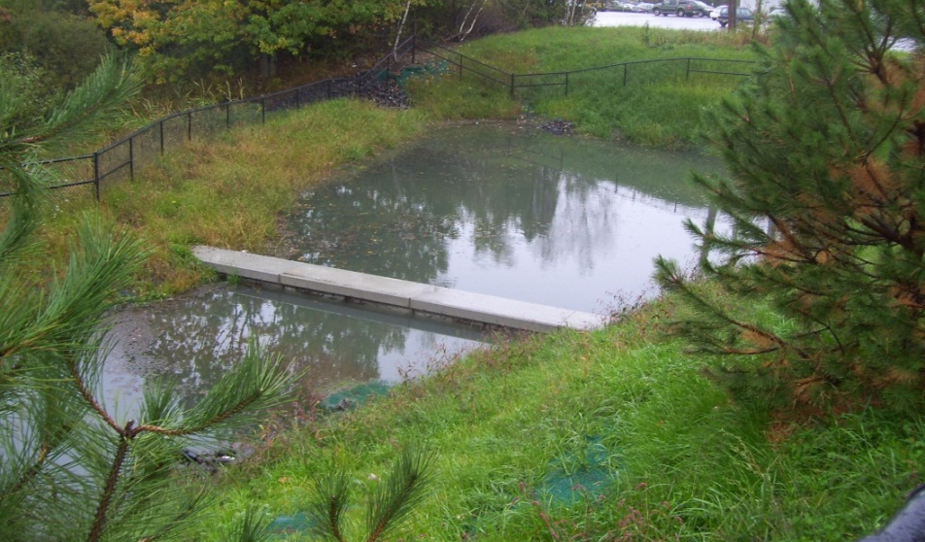
Soil Media Filter - After a 3.75” rainstorm
Completed Soil Media Filter – cost /acre treated $82,540
Notes:
Able to complete Phase II utilizing landowner initial annual assessments.

Slide 18
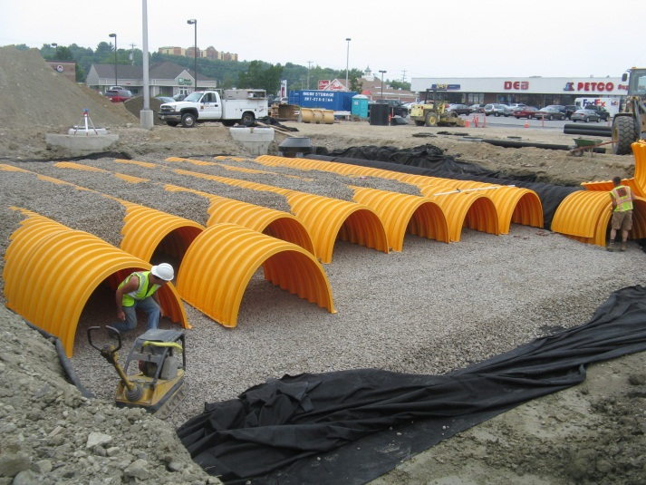
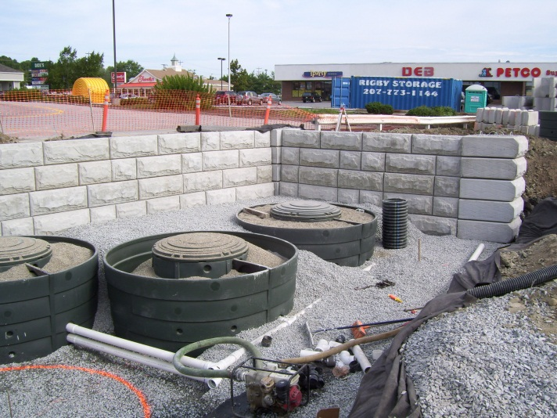
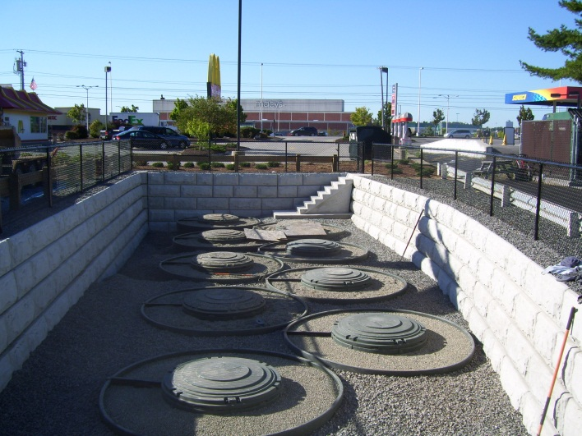
Mall Plaza Phase II Priority Retrofit
Site Characteristics Project Cost
Impervious Cover Treated: 3.5 acres Engineering & Oversight: $ 29,968
Construction: $ 253,850
Cost /acre treated $82,176 Legal & Administration: $ 3,799
Total $ 287,617

Slide 19
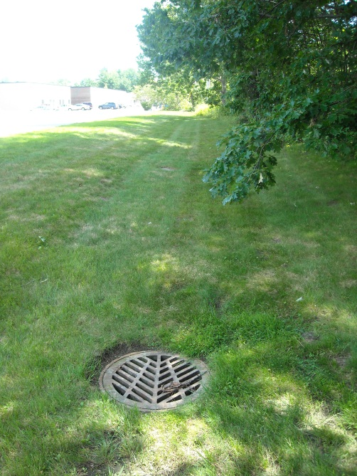
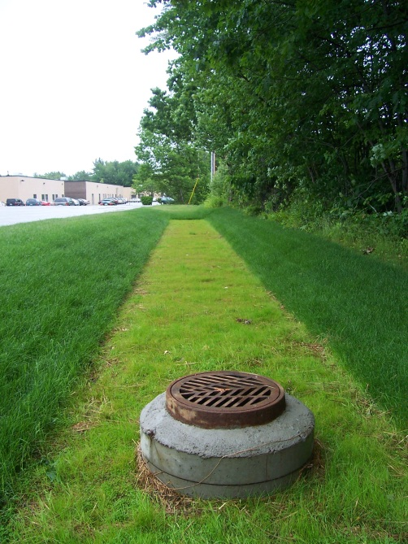
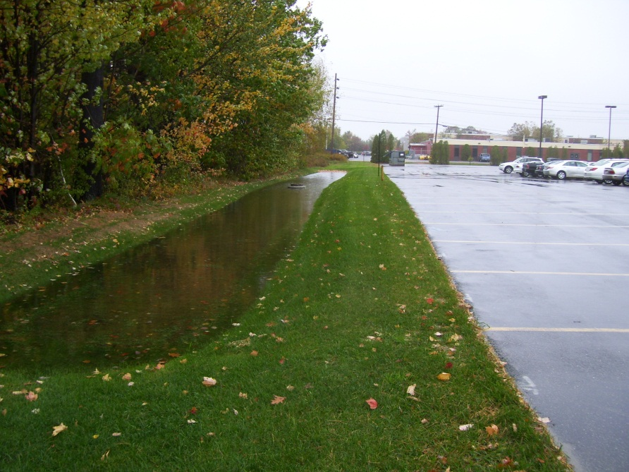
Darling Avenue, South Portland
Site Characteristics Project Cost
Impervious Cover Treated: 7.21 acres Engineering & Oversight: $102,570
Construction: $390,550
Cost /acre treated $70,549 Legal & Administration: $ 15, 537
Total $ 508,657
Before
After

Slide 20
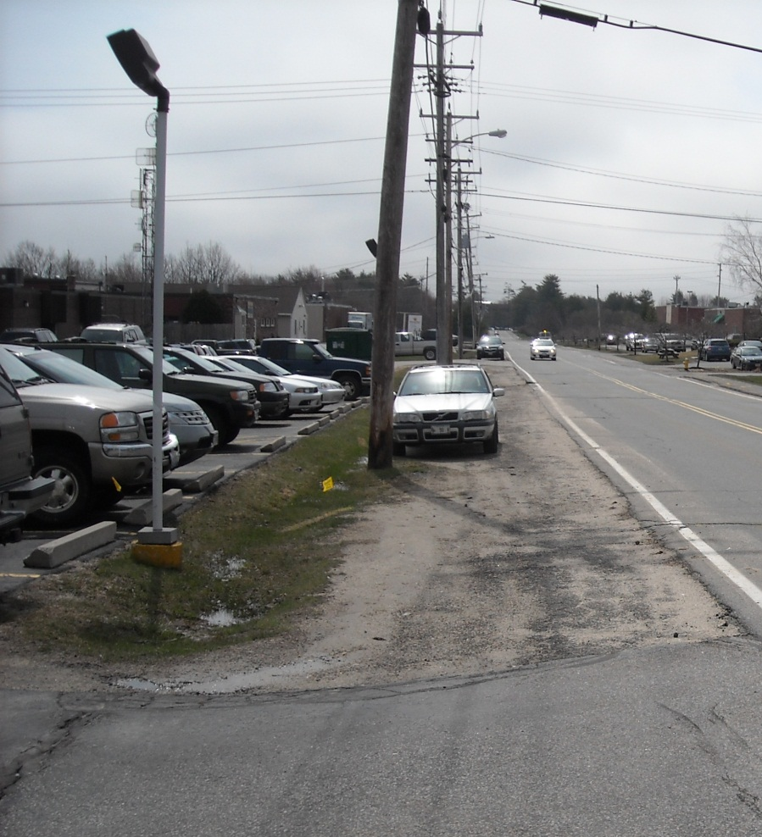
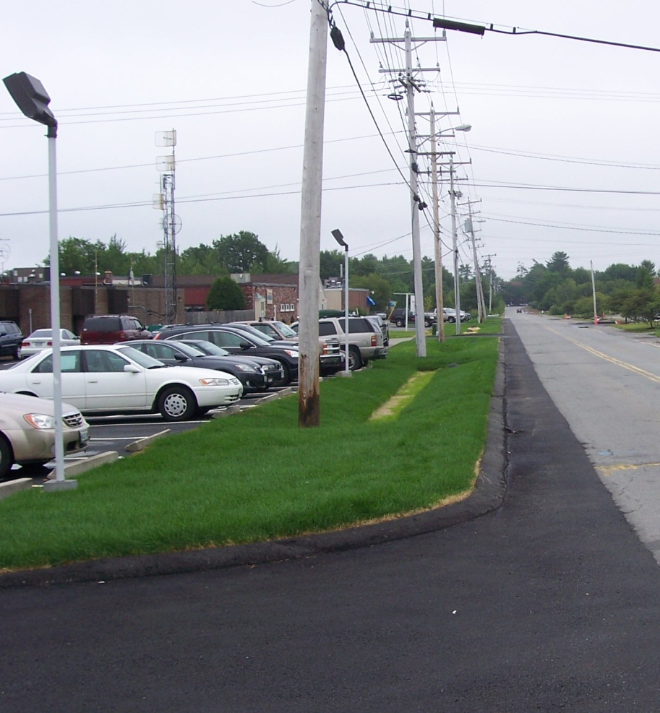
Darling Avenue, South Portland
Conveyance Soil Filter
Before
After

Slide 21
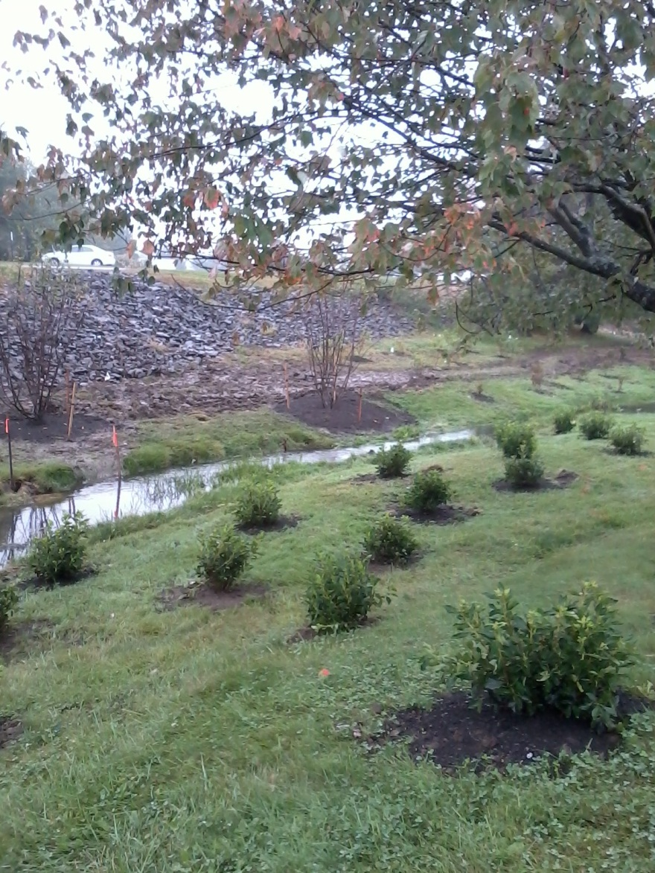
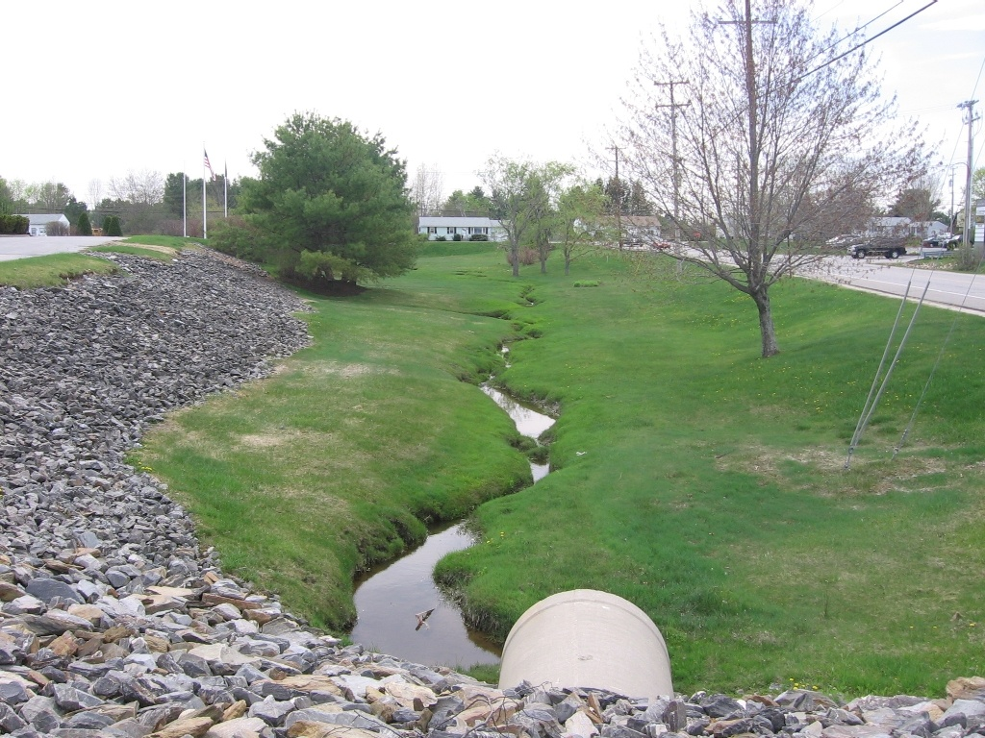
Blanchette Brook, Westbrook

Slide 22
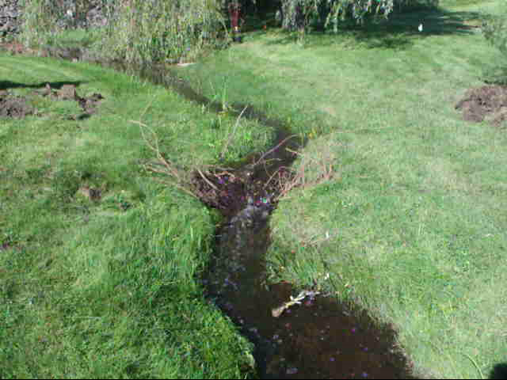
Blanchette Brook, Westbrook

Slide 23
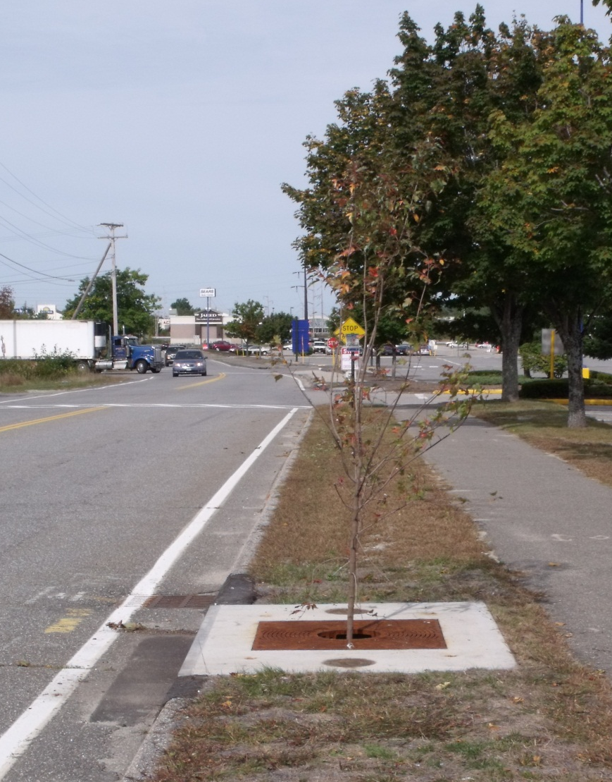
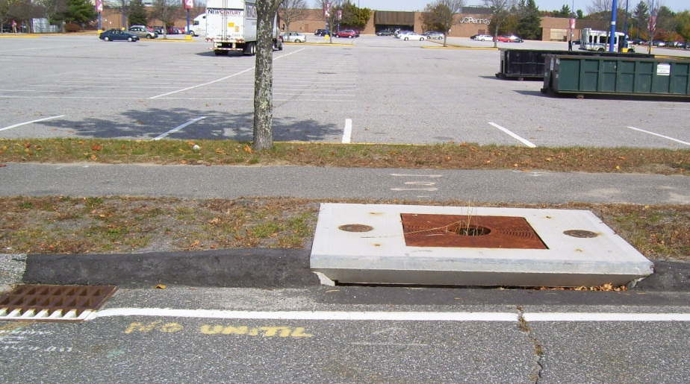
Ongoing Challenges
Stay tuned, more changes expected as the conversations continue…
Notes:
To tree or not to tree?

Slide 24
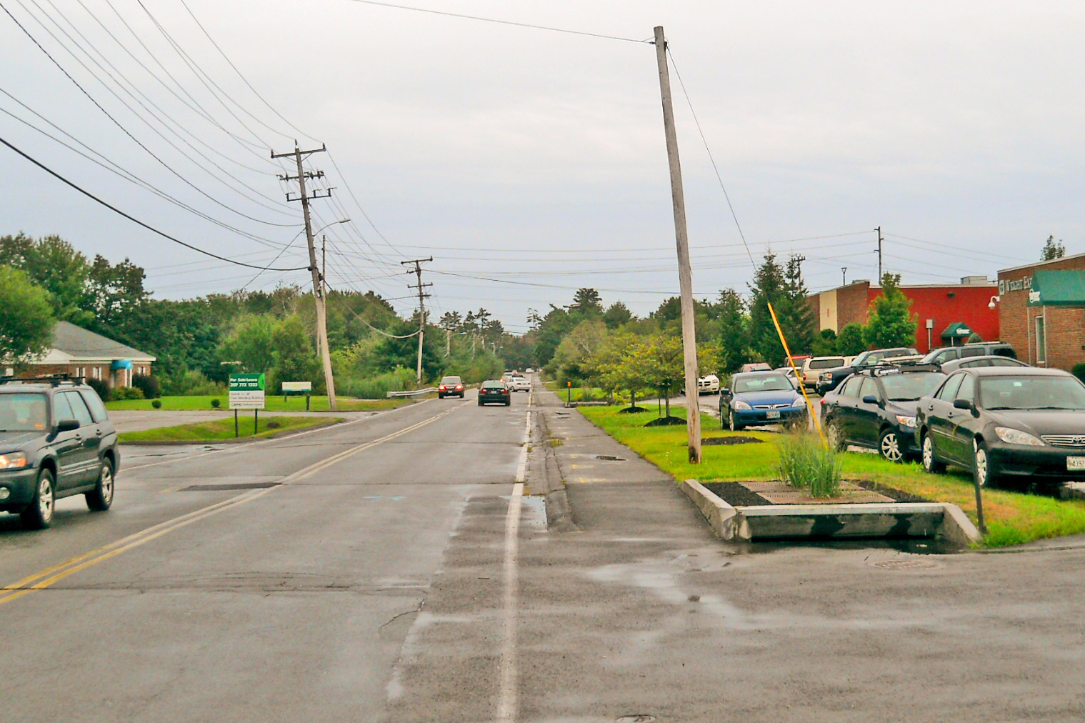
Summer

Slide 25
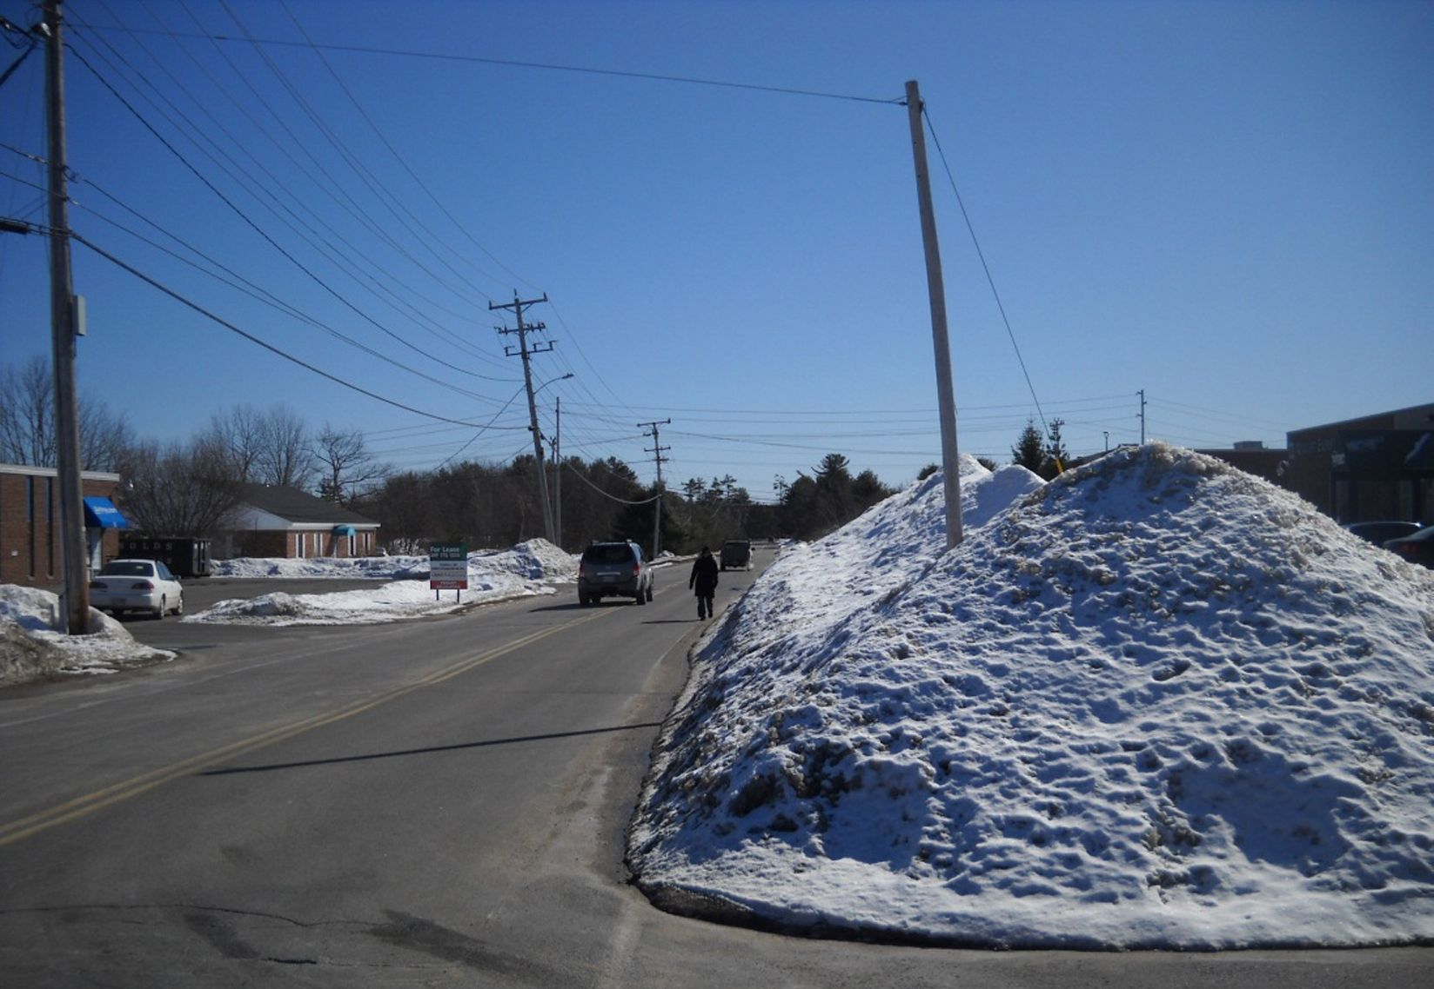
Winter

Slide 26
Flow Monitoring sites

Slide 27
Sondes Monitoring sites
permanent & rotating

Slide 28
Dissolved Oxygen: Main Stem
SITE 07 – Upper Main Stem
June
June
August
December
February
October
SITE 02 – Lower Main Stem
June
August
December
February
June
October
Notes:
Data from the Main Stem. Site 7 is on the Main Stem adjacent to Thomas Drive. Site 2 is on the Main Stem downstream of Foden Road & immediately upstream of the confluence with the North Branch.
Purple horizontal line is 5 mg/L (Class C criterion). Light red horizontal line is 7 mg/L (Class B Criterion). Blue X shows the period when the DO at this station was below the Class C Criterion.
While not definitive, these data suggest that adding shade to the upper Main Stem (e.g., the Colonel Westbrook Planting Project) may reduce the frequency of periods where DO is below 5 mg/L. It is unlikely that shading alone will allow this section of the stream to meet Class B (7 mg/L) standards, however, since it is likely that groundwater discharge into the stream contributes low DO water and the channel morphology (shallow, low gradient) does not introduce substantial oxygen in this stretch of the stream. Data collected from Site 5 (not shown here, located upstream of the Maine Turnpike and within a stretch of the Main Stem that is shaded, extensively vegetated, and has natural deadfall that promote aeriation) shows less extreme DO conditions and fewer periods of DO below 5 mg/L. This stretch of the Main Stem still shows periods where the DO does not meet Class B conditions, however. Therefore, upstream shading may reduce the temperature of water flowing into the Site 5 area and may allow greater temperature (and DO) recovery within this stretch.

Slide 29
Dissolved Oxygen: North Branch
SITE 03 – North Branch
October
August
June
December
February
June
Darling Ave BMP Construction Complete
Notes:
Data from Site 3, which is located on the North Branch downstream of the Foden Road Crossing and immediately upstream of the confluence with the Main Stem. This station is downgradient of the majority of the impervious in the northwest portion of the watershed (Darling Ave & Foden Road)
Purple horizontal line is 5 mg/L (Class C criterion). Light red horizontal line is 7 mg/L (Class B Criterion). Blue X shows the period when the DO at this station was below the Class C Criterion.
Site 3 data demonstrate that the North Branch has a significant warming trend (thus periods of low dissolved oxygen) beginning in late May (or following spring melt). These conditions predominate throughout the summer months and the stream temperatures/dissolved oxygen in mid-September (or when daytime temperatures moderate and nighttime temperatures are cooler).
The North Branch DO conditions are likely related to a combination of discharge of heated water from the impervious cover in this highly developed area and lack of aeration due to the low gradient channel. An additional year of monitoring data will help us evaluate whether the structural BMPs implemented along Darling Avenue have resulted in improved DO conditions in the North Branch or if additional BMPs are required to allow this branch to meet Class C standards for DO.

Slide 30
Dissolved Oxygen: South Branch
SITE 01 – South Branch
October
June
June
December
February
Notes:
Data from Site 1, which is located on the South Branch downstream of Philbrook Ave. This station is downgradient of the majority of the impervious in the southern portion of the watershed (Maine Mall Road south of Gorham Road, Philbrook Ave, and associated commercial properties).
Purple horizontal line is 5 mg/L (Class C criterion). Light red horizontal line is 7 mg/L (Class B Criterion). Blue X shows the period when the DO at this station was below the Class C Criterion.
Site 1 data demonstrate that the South Branch behaves similarly to the North Branch. It has a significant warming trend (thus periods of low dissolved oxygen) beginning in late May (or following spring melt). These conditions predominate throughout the summer months and the stream temperatures/dissolved oxygen in mid-September (or when daytime temperatures moderate and nighttime temperatures are cooler).
The South Branch shows periods of low DO (less than 5 mg/L) in the summer, and this is likely related to a combination of discharge of heated water from the impervious cover in this highly developed area and lack of aeration due to the low gradient channel. As with the Upper Main Stem, shading alone is not likely to address the DO concerns in the South Branch; however, a combination of shading, channel geomorphology improvements, and structural BMPs designed to reduce the temperature of stormwater discharged into the channels could allow the South Branch to meet Class C standards for DO.

Slide 31
Chloride during Spring Runoff
Spring Melt
Late Spring Rain
Groundwater Inflow
First Flush
Specific Conductance (us/cm)
Chloride (mg/L)
End of Storm
Site 03
(North Branch)
Spring 2011
Notes:
This chart takes Spring 2011 data from Site 3 (off of Foden Road on the North Branch). The red horizontal line is the Maine Chronic Concentration Criterion for chloride. For all except 1 sampling event, Site 3 exceeded the CCC. This is representative of conditions across the watershed this spring.
During spring melt, large amounts of salt dissolve into meltwater and run off into the stream. Over the course of the spring melt period, the chloride works its way through the system and concentrations in the surface water decrease. During rain events salt that remains on the impervious surfaces as well as salt that is in nearby soil is dissolved and we see a secondary chloride spike. Once the spring melt and storms are completed, we see a third increase in chloride concentrations as the stream enters baseflow conditions (where it receives more water from groundwater sources and less from precipitation and runoff).

Slide 32
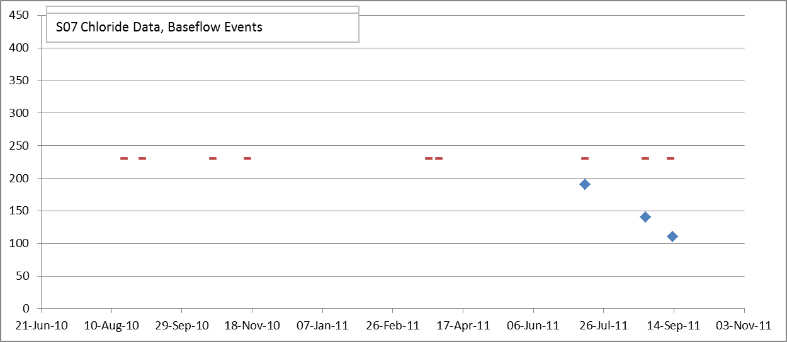
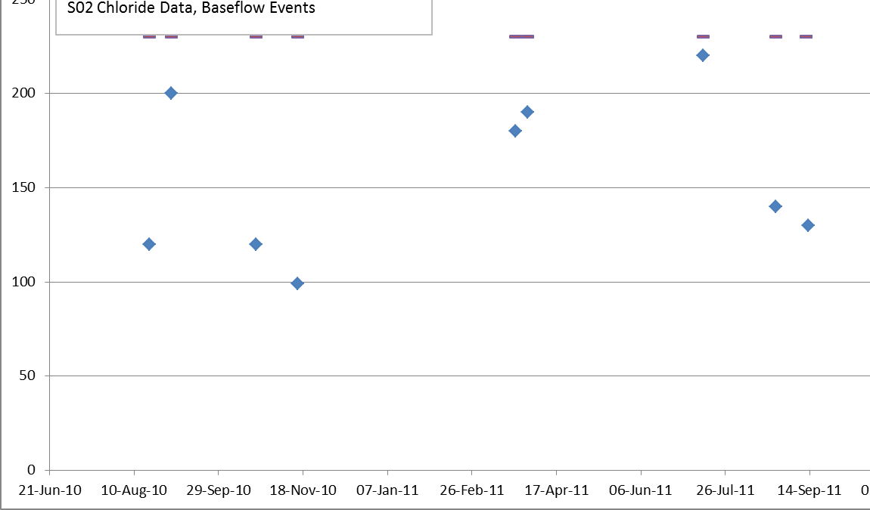
Chloride: Main Stem Baseflow
SITE 07 – Upper Main Stem
SITE 02 – Lower Main Stem
SITE 02 – Lower Main Stem
June
Notes:
Data from the Main Stem. Site 7 is on the Main Stem adjacent to Thomas Drive. Site 2 is on the Main Stem downstream of Foden Road & immediately upstream of the confluence with the North Branch.
These charts depict chloride analytical data for baseflow samples collected from the Main Stem in 2010 and 2011. The red horizontal line the criterion for Chloride (230 mg/L). According to data collected to date, chloride does not exceed the criterion during baseflow conditions. This suggests that the groundwater discharging into the Main Stem near Sites 7 & 2 does not have a high enough chloride concentration to cause the stream water to exceed criteria. In order to maintain this condition in the upper watershed (since chloride impacts are cumulative), LCWMD is actively implementing nonstructural BMPs designed to minimize chloride usage in the watershed wherever possible.

Slide 33
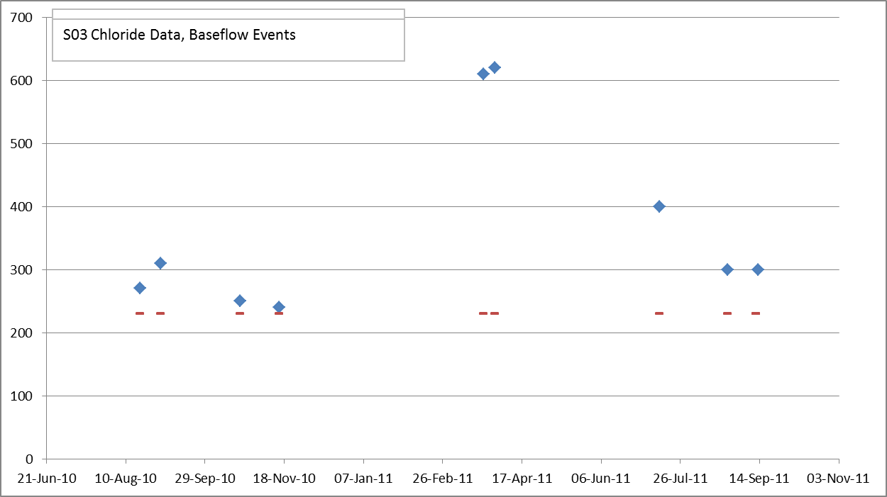
Chloride: North Branch Baseflow
SITE 03 – North Branch
Notes:
Data from Site 3, which is located on the North Branch downstream of the Foden Road Crossing and immediately upstream of the confluence with the Main Stem. This station is downgradient of the majority of the impervious in the northwest portion of the watershed (Darling Ave & Foden Road)
These charts depict chloride analytical data for baseflow samples collected from the North Branch in 2010 and 2011. The red horizontal line the criterion for Chloride (230 mg/L). These data suggest that there is a signficant groundwater contribution of chloride into the stream coupled with direct discharge during the spring snowmelt period. Additional analysis is ongoing and the results will be presented in the Monitoring Summary Report at the January 2012 Annual Meeting.

Slide 34
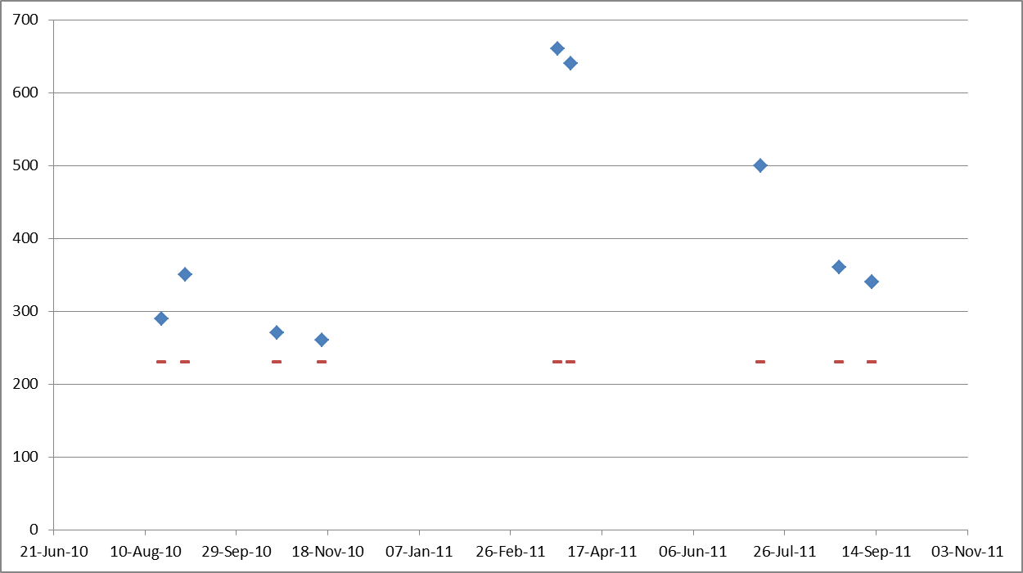
Chloride: South Branch Baseflow
SITE 01 – South Branch
Notes:
Data from Site 1, which is located on the South Branch downstream of Philbrook Ave. This station is downgradient of the majority of the impervious in the southern portion of the watershed (Maine Mall Road south of Gorham Road, Philbrook Ave, and associated commercial properties).
These charts depict chloride analytical data for baseflow samples collected from the South Branch in 2010 and 2011. The red horizontal line the criterion for Chloride (230 mg/L). These data suggest that there is a signficant groundwater contribution of chloride into the stream coupled with direct discharge during the spring snowmelt period. Additional analysis is ongoing and the results will be presented in the Monitoring Summary Report at the January 2012 Annual Meeting.

Slide 35
Metals
Copper, Lead, and Zinc have been detected exceeding criteria for both stormflow and baseflow conditions.
Notes:
Analysis is ongoing and will be presented in the Monitoring Summary Report at the January 2012 Annual Meeting.

Slide 36
Monitoring Summary
The data collected during 2010 and 2011 suggest the following:
  Temperature and dissolved oxygen are major stressors in the upper portion of the watershed.
  Chloride is a major stressor in the lower portion of the watershed in the branches that receive direct discharge from impervious cover.
  Water quantity is a known issue throughout the watershed and is being analyzed further.
Notes:
Further evaluation is ongoing and a more comprehensive report will be presented at the Annual Meeting in January.

Slide 37


Educational Partners
Service learning projects with
Unity College (Dr. Lois Ongley).
Street Dust and stream sediment core sampling/evaluation with University of Southern Maine
(Dr. Luci Benedict).
Notes:
Unity:
1 group is evaluating temperature changes across watershed.
1 group is looking at chloride dataset, winter maintenance BMPs, and policy implications
Presentations at CCSWCD on 12/2/11, 1:30 pm.
Purpose of this is to develop a model for future partnerships.
USM
Selected to submit full proposal for Water Resources Research Institute (decision expected in December)
Going forward , plan to expand the collaboration to evaluate and compare surface water & sediment data

Slide 38

What’s Next?
Engineering of Catchment B-21
(Thomas Drive, Westbrook) for
construction Spring/Summer 2012
Assessment of vacuum sweeping and catch basin cleaning frequencies
Further evaluating chlorides and winter maintenance practices

Slide 39
Thank you
Long Creek Watershed Management District
www.restorelongcreek.org
www.cumberlandswcd.org
tamara@cumberlandswcd.org

