Slide 1
Environmental Public Health Risks Lead Poisoning, Arsenic in Well Water, Extreme Heat
Andrew Smith, SM, ScD
State Toxicologist
E2Tech Meeting
November 19, 2015

Slide 2
Childhood Lead Poisoning
1-in-25

Slide 3
Rates of Childhood Lead Poisoning
Rates are Declining
Notes:
T1/2 decay rate of 6.5 years.

Slide 4
Burden of Childhood Lead Poisoning
1600+ Children with an eBLL
400+ Children Each Year
Notes:
NHANES – 2.5% children 1-5 years old have BLL >= 5 ug/dL. 0.025*65,000 = 1640.

Slide 5
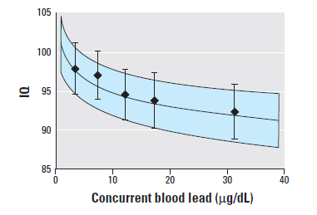
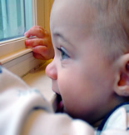
No Safe Level
IQ deficits at low blood lead levels
Lanphear et al., VOLUME 113 | NUMBER 7 | July 2005 • Environmental Health Perspectives

Slide 6
Social Cost of Childhood Lead Poisoning
Effect of Reduced IQ on Future Earnings
Lead
IQ
Income
Earnings
J. Schwartz, VOLUME 66| 1995 • Environmental Research

Slide 7
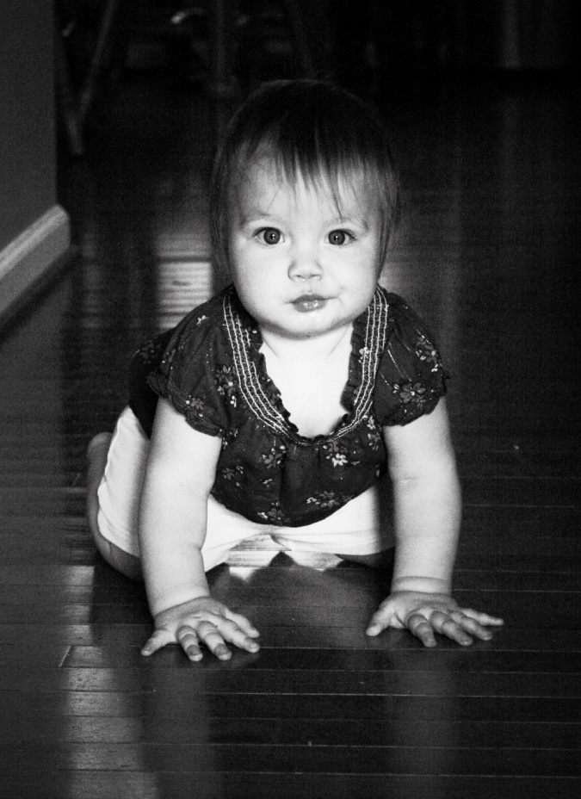
Social Cost of Childhood Lead Poisoning
For Each Birth Cohort ……
$21 - $145 million
in reduced future earnings
for 1 year olds born in 2010 and tested for blood lead
$42 - $290 million
full birth cohort
Notes:
UMO economist got similar results ($250 million per birth cohort), ..and an Amherst economist reported that a 1 ug/dL change in blood lead has the safe effect as $5,000 in family income.

Slide 8
Arsenic in Well Water
Is your well water safe to drink?
1-in-10

Slide 9
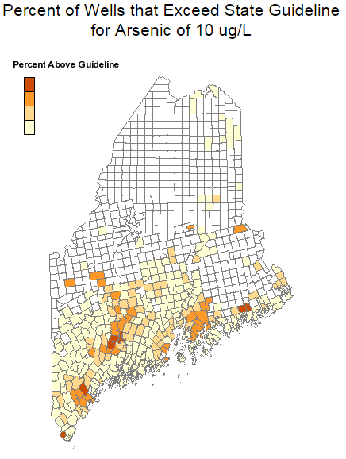
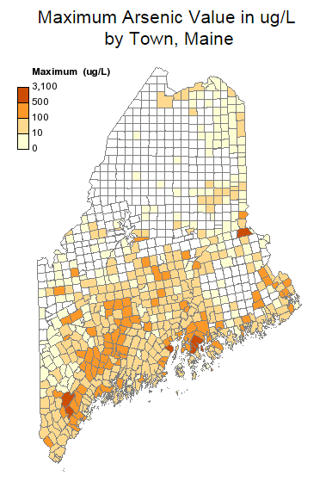
Arsenic in Well Water
Is your well water safe to drink?
45
30
15
0
Source: Maine Tracking Network: https://data.mainepublichealth.gov/tracking/

Slide 10
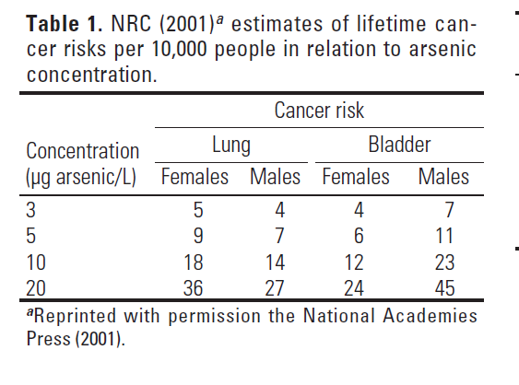
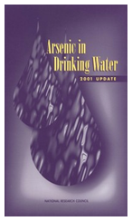
Arsenic and Cancer
Bladder and Lung
1-in-1000

Slide 11
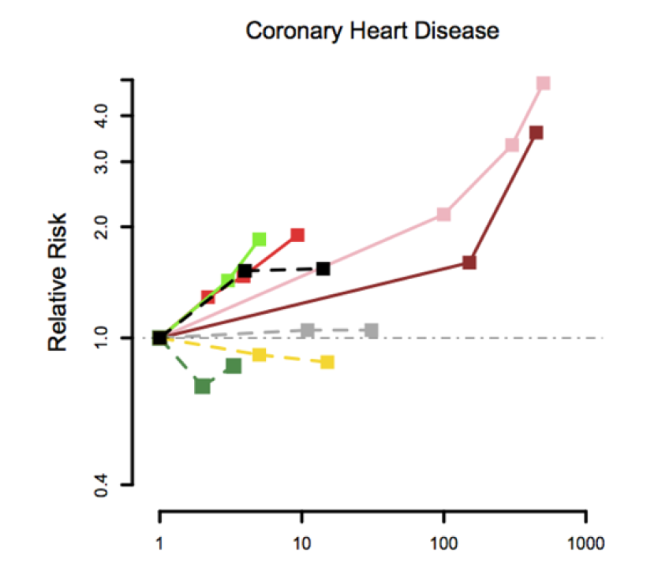
Arsenic and Heart Disease
Coronary Heart Disease

Slide 12
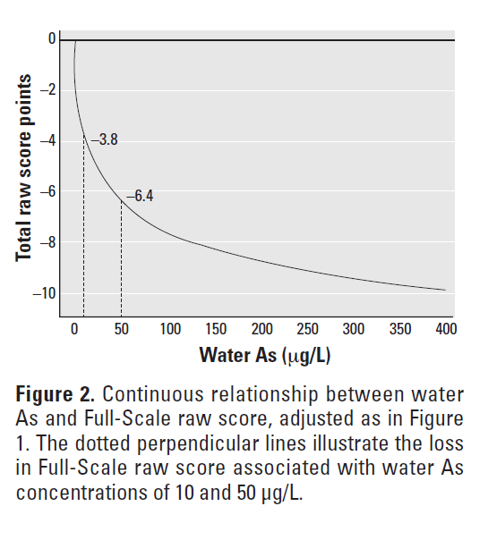
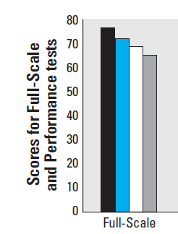
Arsenic and Intellectual Function
Bangladesh
Notes:
Think about fixing this. …..

Slide 13
Population Exposure
Some Back-of-the-Envelope Calculations
355,000 Maine households on private wells
About 887,500 people
12% have As > 10 ug/L
106,500 people with water As > 10 ug/dL
5,300 children less than 6 years
Notes:
Think about fixing this. …..

Slide 14
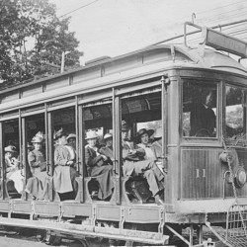
Extreme Heat Event
It’s Rare
1911:
Last extreme heat event in Maine with more than 5 days of temperatures near or above 100.
Courtesy of Dick Shaw

Slide 15
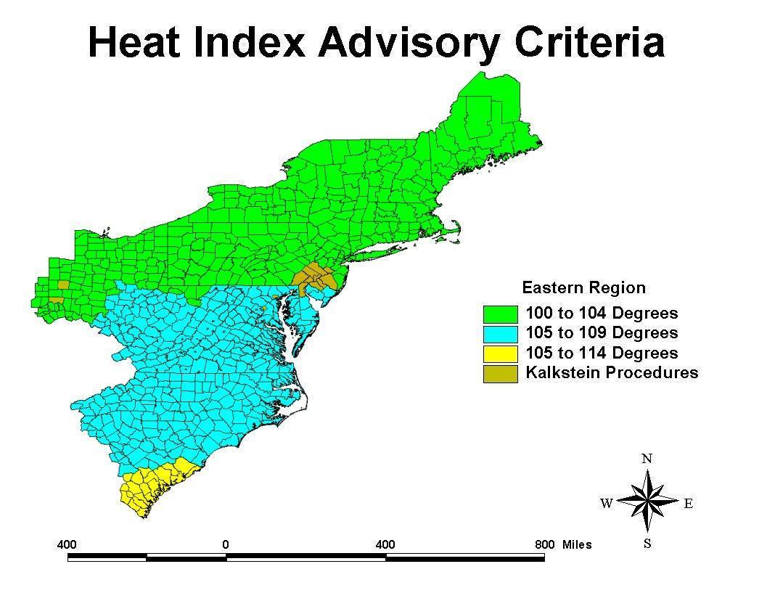
Extreme Heat Event
But, What is Extreme?

Slide 16
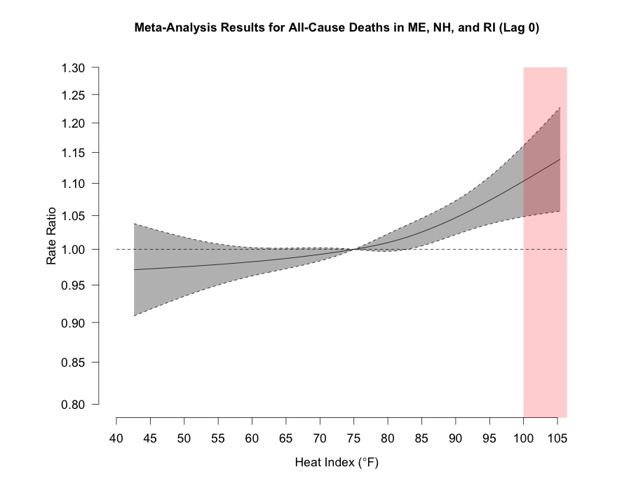
Extreme Heat Event
Increased Mortality with Heat
Risk increases by 7.6% (95% CI: 3.6, 11.8) on days with max HI of 95°F (as compared to 75°F)
Source: ME-CDC: Preliminary data – Unpublished.
Notes:
5 excess deaths per day with 95 HI, and 66 excess ED visits, statewide. About 35 deaths per day on average.

Slide 17
Predicted Excess Deaths
Statewide for Maine
HEAT INDEX THRESHOLD | 95 | 100 | 105
Excess deaths per day (compared to 75F) | 5 | 7 | 9
Excess ED visits per day (compared to 75F) | 66 | 99 | 116
On average, about 30 deaths per day
Source: ME-CDC: Preliminary data – Unpublished.
Notes:
5 excess deaths per day with 95 HI, and 66 excess ED visits, statewide. About 30 deaths per day on average.

Slide 18
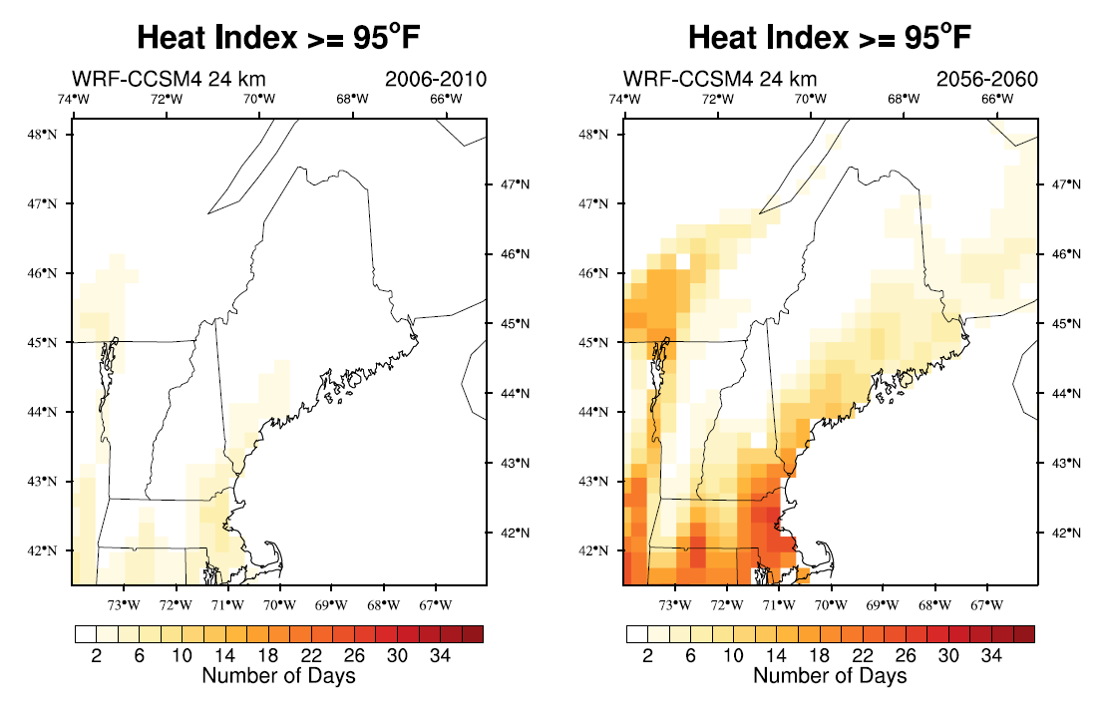
Changing Climate?
2056 Projections
Source: University of Maine – Climate Change Institute: WRF Predictions using IPCC AR5 RCP 8.5 Forcing
Notes:
Climate Change Institute. Weather Research and Forecasting Model (WRF). Global modeling outputs (IPCC AR5 RCP 8.5 Forcing) used as inputs for local WRF model predictions

Slide 19
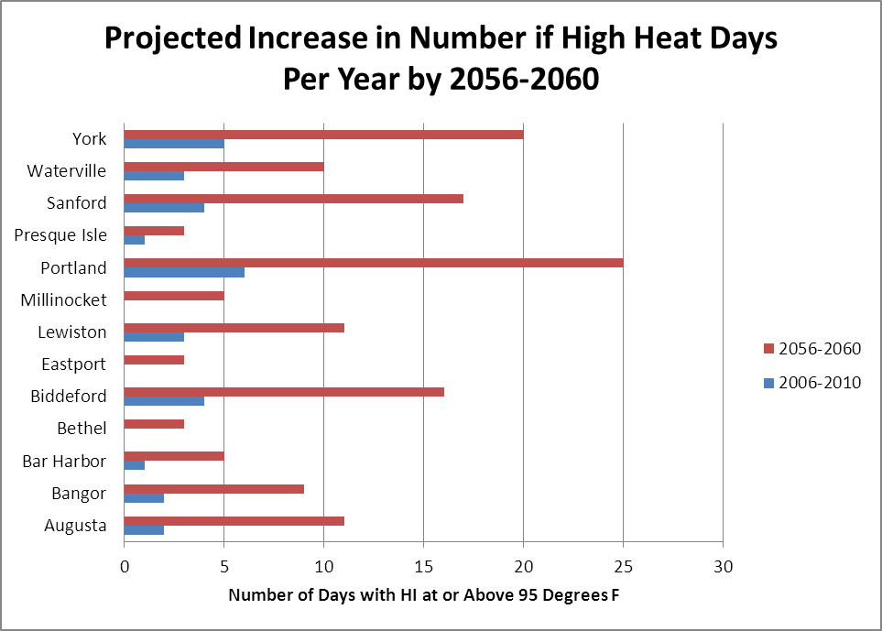
More High Heat Days?
2056 Projections
Source: University of Maine – Climate Change Institute: WRF Predictions using IPCC AR5 RCP 8.5 Forcing
Notes:
Climate Change Institute. Weather Research and Forecasting Model (WRF). Global modeling outputs (IPCC AR5 RCP 8.5 Forcing) used as inputs for local WRF model predictions

Slide 20
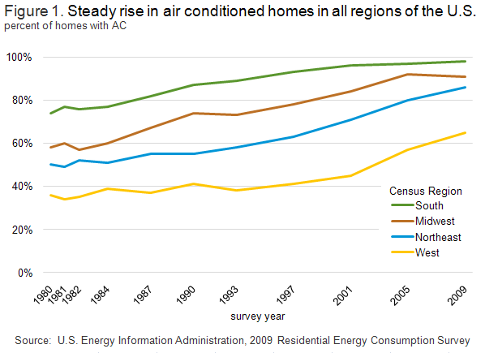
Vulnerability
We’re the 3rd Oldest State without much AC
In Maine, 53% households report having AC; most are window units
(Source: Maine Tracking Network).
Notes:
Maine has 15.3% of population 65 or older., 3rd highest in US. http://www.census.gov/prod/cen2010/briefs/c2010br-09.pdf

Slide 21
If Questions
Andrew Smith, SM, ScD
State Toxicologist
Tel: (207) 287-5189
Email: andy.e.smith@maine.gov

