Slide 1
Opportunities For Maine in the Offshore Energy Supply Chain
Presentation at
E2Tech Forum
Portland, Maine
June 21, 2012
Stephen Von Vogt
Maine Composites Alliance
Maine Wind and Ocean Energy Initiative

Slide 2
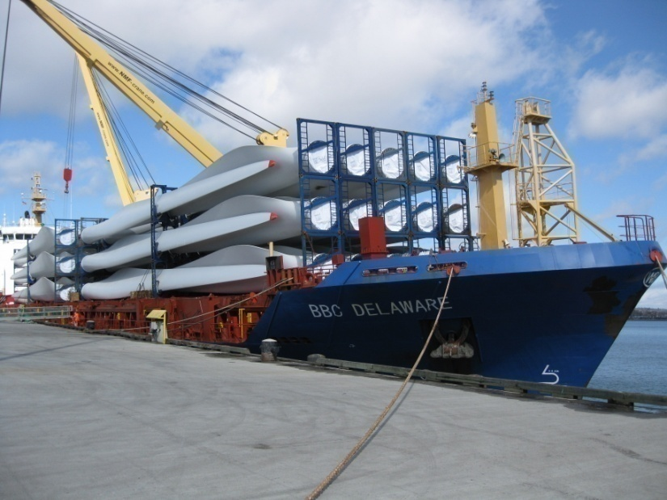
is...
A Wind Industry Supply Chain Network
Organize the full wind power supply chain
Improve knowledge and technology of Maine Industry
Connect out of state companies with Maine partners
Connect Maine industry solutions to world market needs

Slide 3
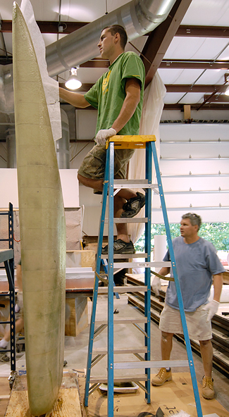
is...
A Composites Industry Development Network
Supports Education and Workforce Development
Supports Research and Development
Connect out of state companies with Maine partners
Connect Maine industry solutions to world market needs

Slide 4
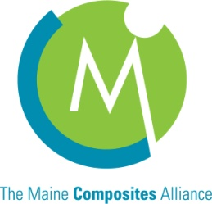
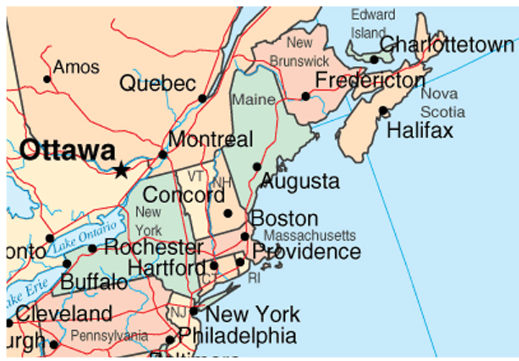
Location Advantage
Maine is at the center of a
major northeast American population center: ~65 Million
Maine provides grid path for the Eastern American/ Canadian Energy Corridor.
Major Deepwater ports providing transportation access throughout US and Canada.
Major Tidal, Offshore and Onshore Wind resources

Slide 5
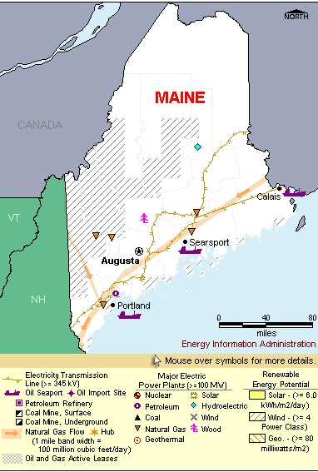
Maine’s current Energy Situation
Key Facts:
The Port of Portland receives crude
oil shipments, which it then sends via
pipeline to refineries in Canada.
Four-fifths of Maine’s households –
the highest share in the Nation – use
fuel oil for heating.
Maine is the only New England State
in which industry is the leading
energy-consuming sector.
Maine generates a larger share of its
electricity from non-hydroelectric
renewable resources than any other
State (Biomass).

Slide 6
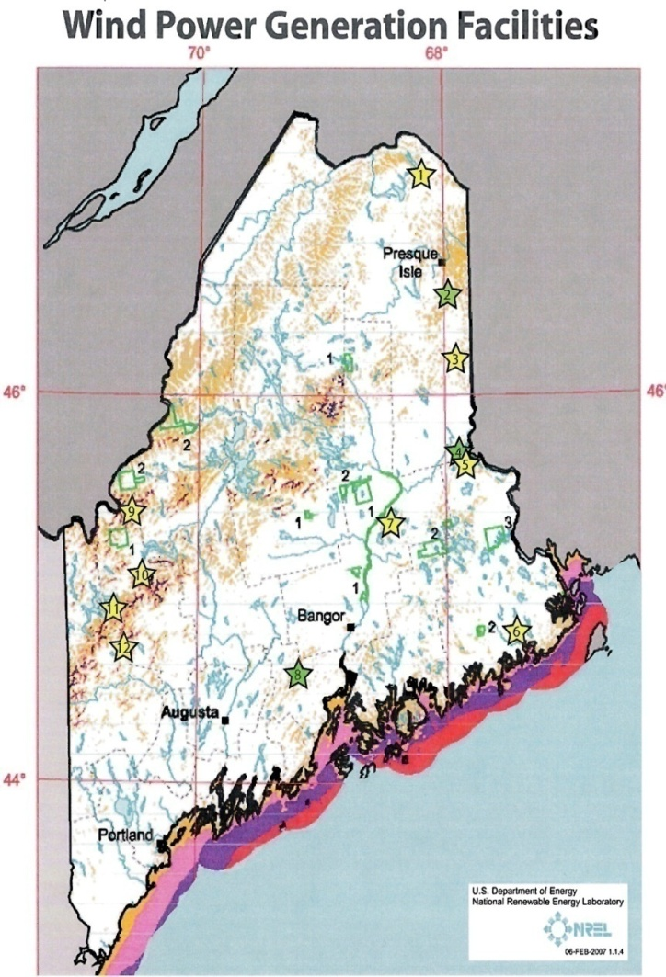
Maine Wind Resources:
Onshore Wind:
375 MW Currently Installed
Maine Wind Potential= 6390 MW.
Offshore Wind Potential: 149 GW resource, (no exclusions, 0-50 nm, assuming class 5 Winds)*
Official State Goals:
2015: 2000 MW
2020: 2700 MW onshore, 300 Offshore
2030: 5000 MW offshore
* Walter Musial (NREL), Presentation, Power of the Gulf Conference, Maine, June 12, 08

Slide 7
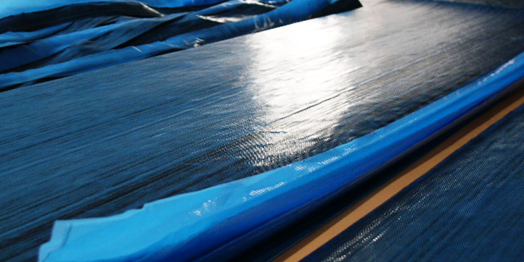
Composite Material:
Definition:
A combination of two or more materials (reinforcing elements, fillers, and composite matrix binder), differing in form or composition on a macroscale.
FRP= Fiber reinforced Plastics

Slide 8
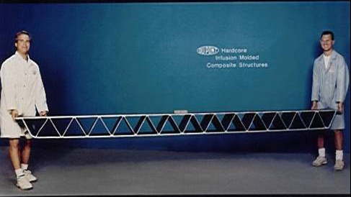
Composites vs. Traditional Materials
Stronger and stiffer than metals on a density basis
For the same strength, lighter than steel by 80% and aluminum by 60%
Superior stiffness-to-weight ratios

Slide 9
Benefits of Composites
High impact strength
Low maintenance
Long term durability
Part consolidation
Small to large part geometry possible
Tailored surface finish
Non-magnetic
Imbedded sensor technology
Light weight
High strength-to-weight ratio
Directional strength
Corrosion & weather resistance
Dimensional stability
Low thermal conductivity
Low coefficient of thermal expansion

Slide 10
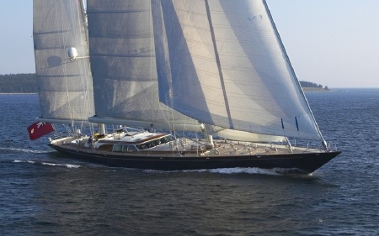
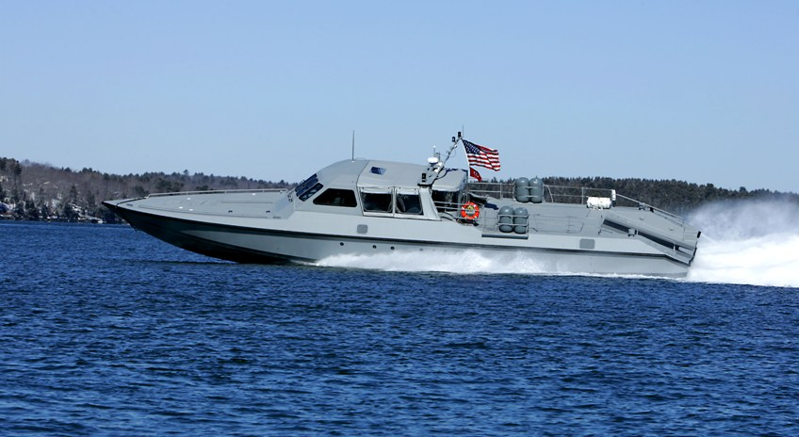
Industry Application of Composites
Boats and vessels for:
Luxury
Military
Commercial

Slide 11
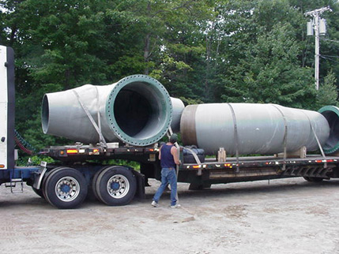
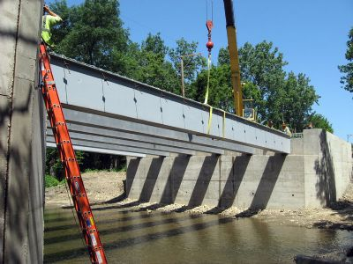
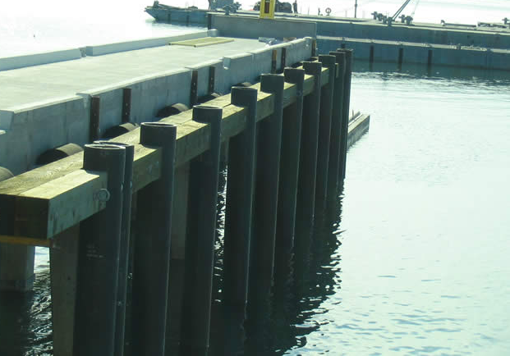
Industry Application of Composites
Industrial Application
Piping Systems
Bridges
Marine Infrastructure

Slide 12
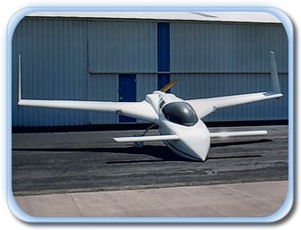
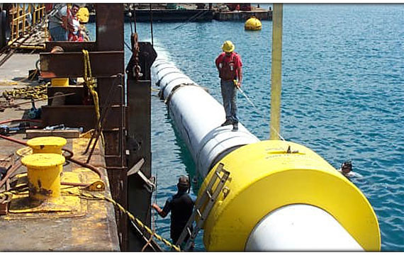
Industry Application of Composites
Off Shore Buoys and floatation
Aerospace

Slide 13
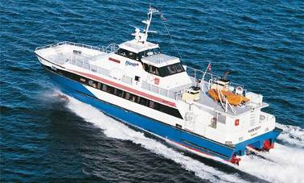
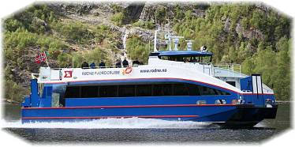
Comparative Application:
Life Cycle Costs High Speed Ferries: Carbon vs. Aluminum
Maintenance Costs over
20 years
Aluminum: € 280,000
Glass: 210,000
Carbon: €210,000

Slide 14
Comparative Application:
Life Cycle Costs High Speed Ferries: Carbon vs. Aluminum
M/S ”FJØRTOFT”
(120 pax, Aluminium)
Fuel Consumtion : 132 Gal/hr at 30 knots
M/S ”RYGERKONGEN”
(130 pax, Carbon Fiber)
Fuel Consumption: 74 Gal/hr at 30 knots

Slide 15
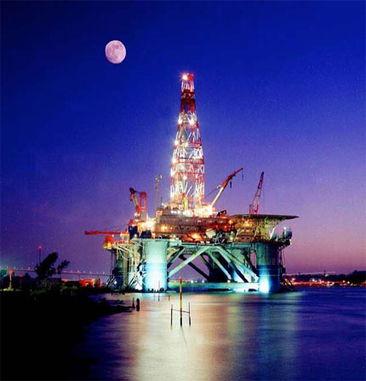
Comparative Application:
Offshore oil composite uses
Reduce Weights and Corrosion Maintenance Costs:
Composite Grids/ Gratings
Hand rails & Ladder Components
Aqueous Piping System
Water & fuel storage tanks, Vessels
Low pressure composite valves
Spoolable type thermosetting tubes
Sump Caissons and pull tubes
Cable support systems
Modular paneling for partition walls
High pressure accumulator bottles
Flexible & Floating Risers, Drill pipe
Sub – sea structural components
Boxes, housings and shelters
Fire water pump casing & sea water lift pump casing
Tendons
Offshore bride connecting between platforms
Blast & Fire protection

Slide 16
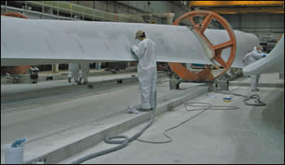
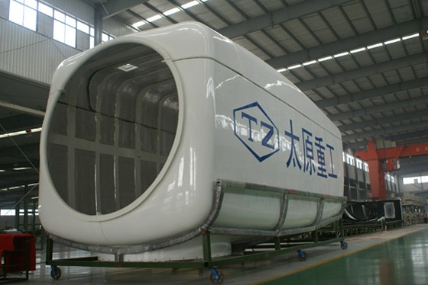
Current application in Wind Industry:
Blades and
Nacelle Housing
Some experimentation with towers and shafts

Slide 17
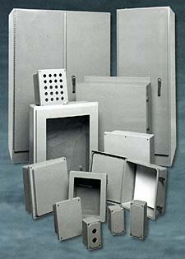
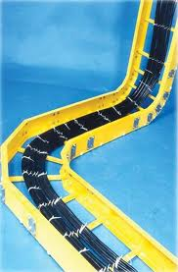
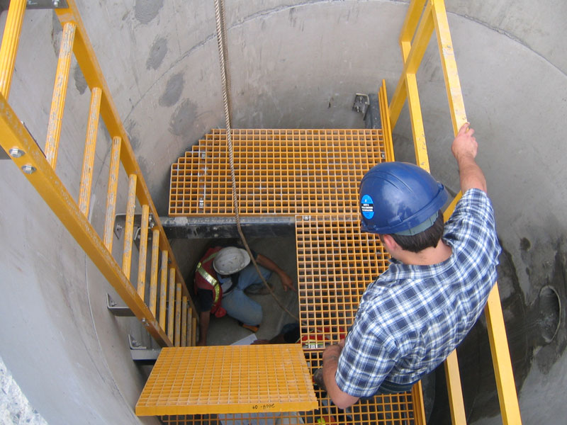
Much More Potential Applications
for Wind Energy:
Weight reduction
corrosion resistance
Ladders,
stairs,
rails,
cable trays and conduit,
piping,
Mechanical and Electrical housings,

Slide 18
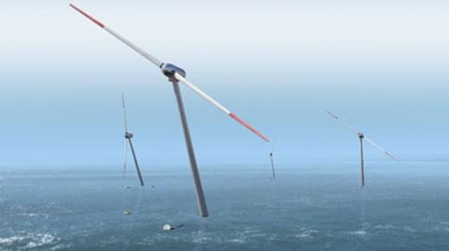
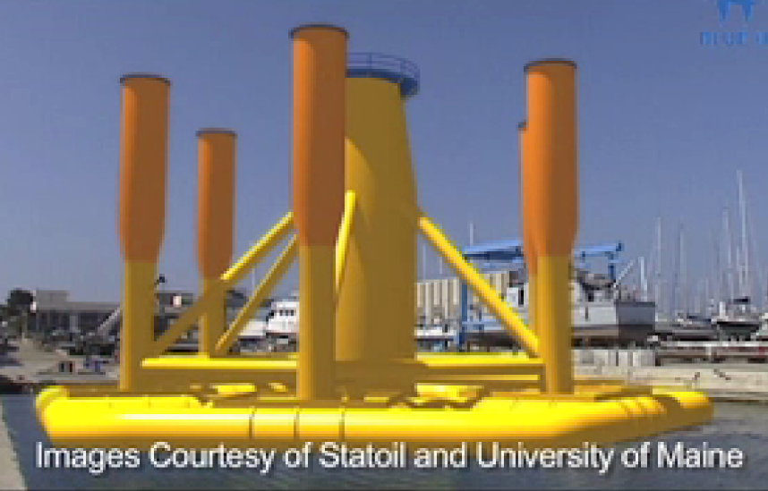
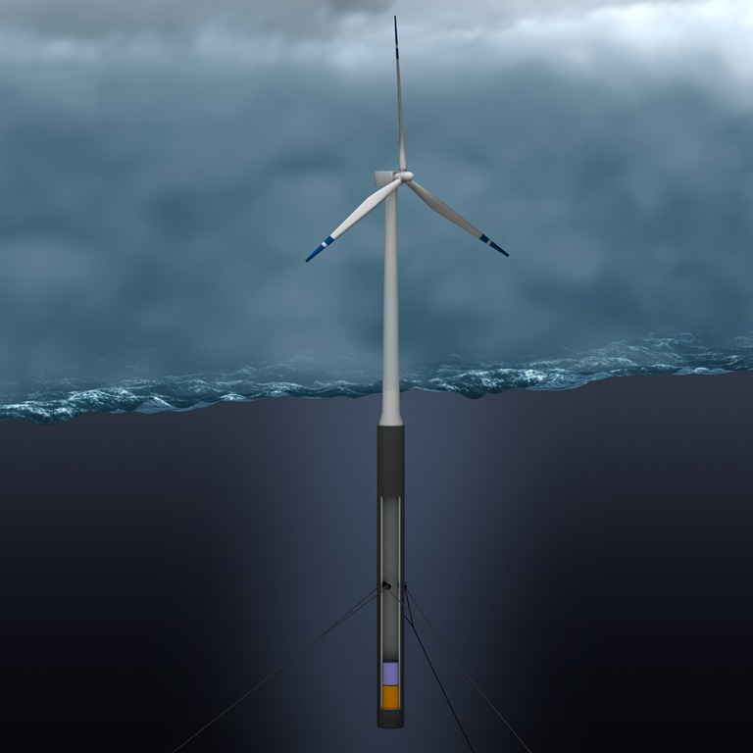
Composite
Solutions
Needed

Slide 19
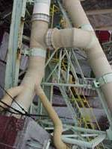
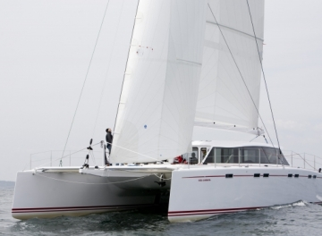
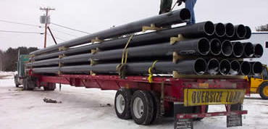
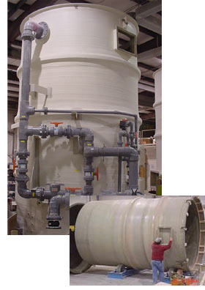
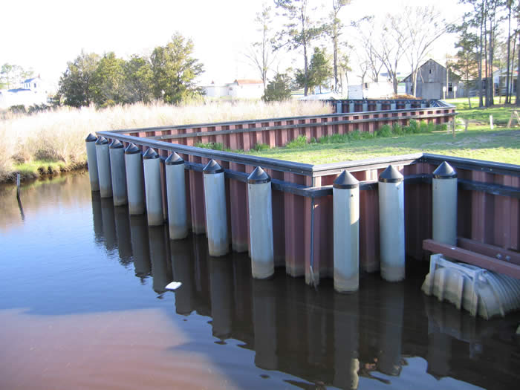
Maine Composite Products

Slide 20
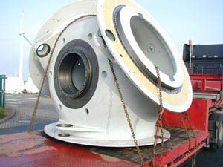
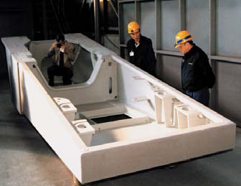
Potential application for larger
wind energy components:
Shafts
Hubs
Nacelle Frames
Towers

Slide 21
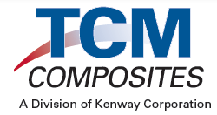
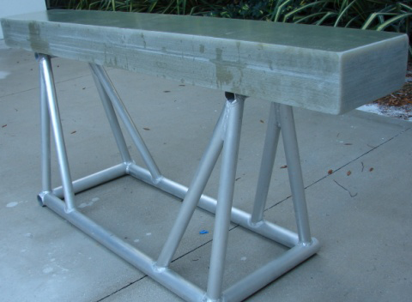
Getting Larger Robust Structural Components from Composites:
TCM Composites provides manufacturing process and technology services for companies adopting the latest in Controlled Radical Polymerization (CRP) technologies.
Superior flow characteristics
Faster production times
Enhanced physical properties
Extended gel times
Managed exotherm temperatures
Cure-on-demand control

Slide 22
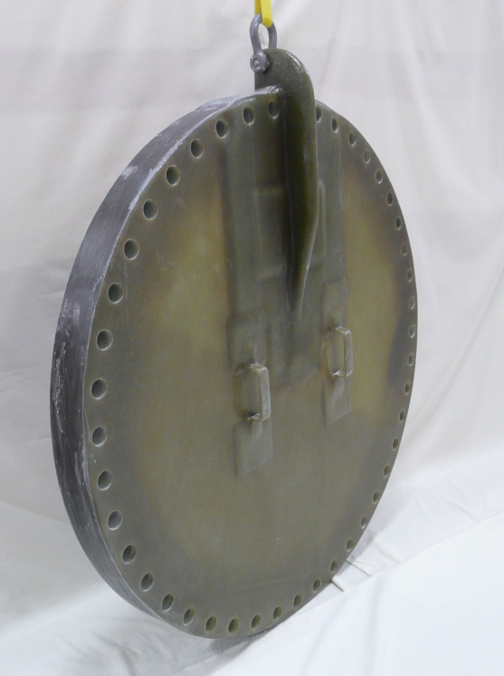
Comparisons to Steel and Iron
Compared to TCM, steel is 4.3 times heavier, cast iron is 3.8 times heavier (aluminum is 43% heavier and carbon FRP is 22% lighter)
TCM is about the same price as simply fabricated mild steel per unit volume,
TCM is only 1/7 as stiff as steel or cast iron.
TCM has almost twice the tensile strength of mild steel and 2-1/2 times that of cast iron or aluminum (and carbon TCM is twice as strong as glass TCM).
One of the biggest advantages of TCM over steel is the ability to dramatically improve fatigue resistance - even more so against cast iron and aluminum.

Slide 23
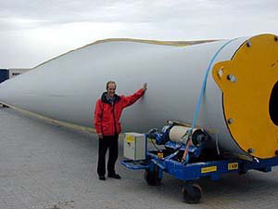
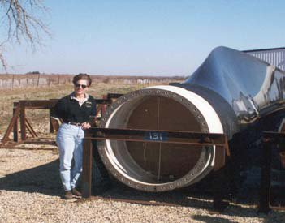
TCM Allows:
Control over producing large or complex structures:
Blade
Towers
Production of thicker accurate laminates for precision structural & mechanical application:
Blade Root Sections
Blade Extenders
Hubs
Nacelle Frames
Shafts
REDUCED WEIGHT!!!

Slide 24
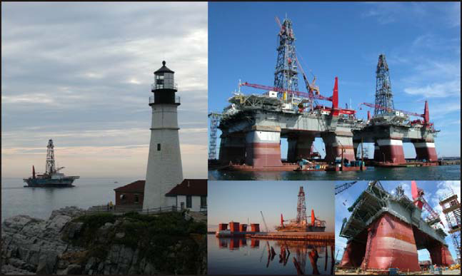
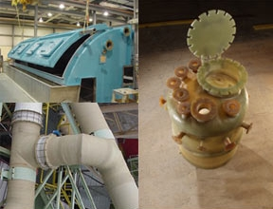
Maine Partners for
Offshore Energy Opportunities
Companies with expertise in Deep Water Solutions:
Floating Oil Exploration Platforms
Composite Buoy and Float Platforms
Composite Marine Infrastructure
North Atlantic Environment Expertise

Slide 25
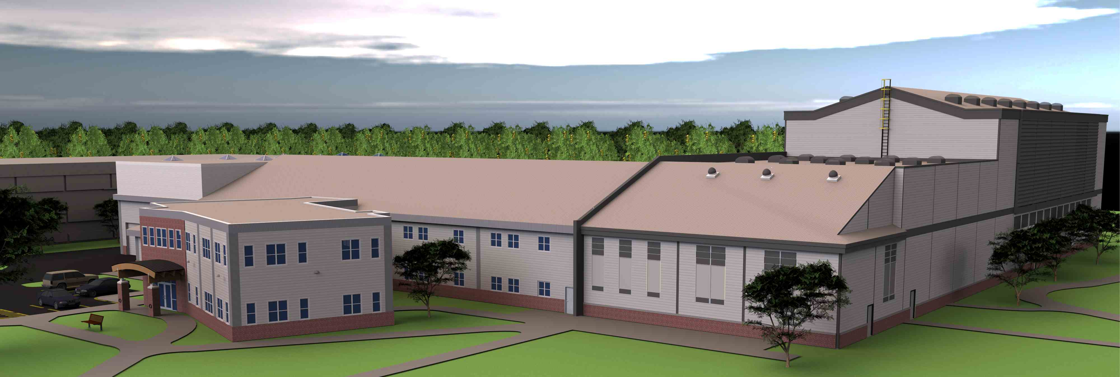
Opportunities in Maine
R&D:
Composite Material Testing
Manufacturing processes
Automated Construction
Blade design and testing
Deepwater prototyping

Slide 26
Why Use Composites for Marine Energy Systems?
• Composite materials are not subject to corrosion degradation.
• Complex shapes are easily formed with composites.
• Lightweight composite structures are easy to handle
and require smaller control machinery.
• Sandwich laminates are ideal for resisting hydrostatic loads.
• Composite laminates have excellent fatigue characteristics.

Slide 27
Maine Ocean Energy Supply Chain
Construction
Manufacturing and Fabrication
Martine Trades
Composites
Professional Services

Slide 28
Construction
CPM CONSTRUCTORS

Slide 29
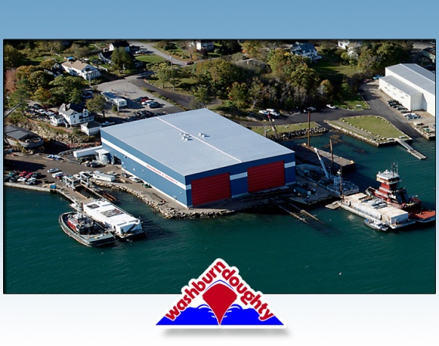
Marine Trades
Strong Boatbuilding and marine trade industry
Examples:

Slide 30
Composites
Strong and diverse composites industry
Examples:

Slide 31
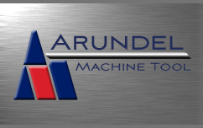
Manufacturing and Fabrication
Maine had robust precision manufacturing stemming from defense and paper industry
High quality work force and statewide presence
Examples:

Slide 32
Professional Services
Maine has a significant critical mass of engineering, environment and other professional serves firms
Examples:

Slide 33
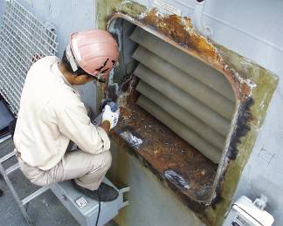
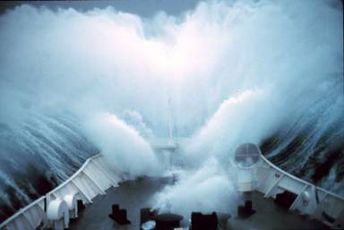
Ocean Environment
Corrosion Extreme Waves
On the open sea, waves can commonly reach seven meters in height or even up to fifteen in extreme weather. In contrast, some reported rogue waves have exceeded thirty meters in height.
Recent studies estimate the direct cost of corrosion in the United States to be nearly$300 billion dollars per year.

Slide 34
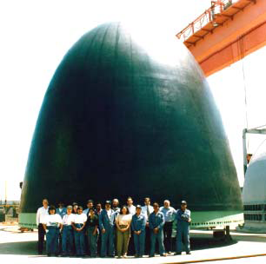
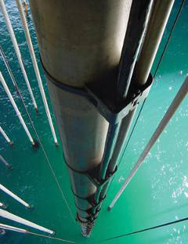
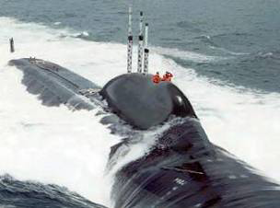
Examples of Large Composite Marine Structures
Composite Submarine Bow
Dome Infused with Epoxy
by Goodrich Composites
Composite Drilling
Riser Developed by
Aker Kvaerner Subsea
Advanced Composite Sail
Envisioned for Virginia Class
Submarines

Slide 35
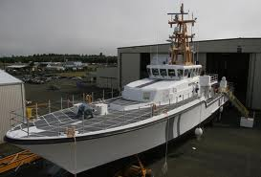
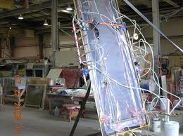
Large Naval Composite Marine Structures
140 foot Global Response Cutter by Westport Ship Building
Twisted Rudder for DDX 1000 from Kenway Corp

Slide 36
Offshore Wind Energy
SWAY technology utilizes a “downstream”
turbine design with aerodynamic turbine housing
and support spar.
Statoil Spar Hywind currently exploring the Gulf of Maine
Principal Power Windfloat deployed off Portugal

Slide 37
Offshore Wind Foundations
37M Floating Power Plant off Denmark
During the MEGAWIND project, testing of this onethird- scale, filament-wound, monolithic-shell tower was conducted at the ELSA laboratory of the JRC,
European Commission, Ispra, Italy

Slide 38
Ocean Tidal and River Energy
Verdant Power
has tidal turbine
installations in
New York and
Canada.
Free Flow Power
River Turbine
ORPC has a long term PPA and is currently deploying off of Eastport Maine

Slide 39
Rotors and Shrouds
Verdant Power
Lunar Energy
ORPC
Free Flow
OpenHydro
Marine Current Turbines

Slide 40
Ocean Wave Energy
Aquamarine Oyster in Orkney
Wavebob deployed west of Ireland
Ocean Power Technologies has installed the first PowerBuoy® system near Reedsport, Oregon

Slide 41
Wave Energy Moving Parts and Foundations
Aquamarine Power
Ocean Power Technology
Wavebob
Pelamis Wave Power
Wavestar

Slide 42
Hydraulic Piping Systems
Aquamarine Power
JPL/Caltech Hydrokinetic
Energy System

Slide 43
Questions?

Slide 44
Contact Information:
Stephen Von Vogt
Maine Composites Alliance
511 Congress Street
PO Box 129
Portland Maine, 04112
Phone +1 207-242-3521
Email pw@mainewindindustry.com
www.mainecompositesalliance.org

