Slide 1
2015 Annual Meeting – Risky Business:
Floods, Fatalities, and Fear
Gold Sponsor
Silver Sponsors

Slide 2
E2Tech Board of Directors
2013 | 2014 | 2015
Brooke Barnes Stantec (environmental consultant) | Jim Atwell Sevee & Maher Engineers (environmental consultant) | Chad Allen Cianbro Corp. (large construction contractor)
Patrick Coughlin St. Germain Collins (environmental consultant) | John Carroll Iberdrola (large electric utility) | David Ertz SunEdison (renewable energy developer)
Bill Ferdinand Eaton Peabody (attorney) | Phil Coupe ReVision Energy (renewable energy) | John Ferland ORPC (renewable energy developer) Secretary & Chair, Strategic Planning
Tim Soley East Brown Cow Management (real estate) | Gary Higginbottom (resigned) Hydrogen Energy Center (renewable energy advisor) | Jim Katsiaficas Perkins Thompson (attorney) Chair: Board of Directors
Elizabeth Swain POWER Engineers (public relations) | Michael Stoddard Efficiency Maine (quasi-government) | Becky Metivier Sage Data Security (information security) Chair: Marketing/Membership
Claudette Townsend Dead River Company (heating fuel, commercial real estate) | Bill Taylor Pierce Atwood (attorney) Chair: Program | Jeff Thaler University of Maine (attorney and professor)
Brad Weller Macpage, LLC (certified public accountant) Treasurer

Slide 3
Board Nominees – E2Tech Member Vote
Existing Board Members
Chad Allen Cianbro Corp. (large construction contractor)
David Ertz SunEdison (renewable energy developer)
John Ferland ORPC (renewable energy developer) Secretary & Chair, Strategic Planning
Jim Katsiaficas Perkins Thompson (attorney) Chair: Board of Directors
Becky Metivier Sage Data Security (information security) Chair: Marketing/Membership
Jeff Thaler University of Maine (attorney and professor)

Slide 4
Board Nominees – E2Tech Member Vote
Our new board member candidates are:
Kelly Boden - Partner, Verrill Dana
Tom Eschner – Senior Principal/Senior Project Manager, Woodard & Curran
Michelle Neujahr - SMCC Entrepreneurial Center Director, Business Faculty, Southern Maine Community College
Steve Westra – Supply Chain Project Manager, Maine Manufacturing Extension Partnership
Sarah Watts- Managing Environmental Scientist/ Operations Manager, Tetra Tech

Slide 5
Mission Statement
The Environmental and Energy Technology Council of Maine is the state’s leading energy, environmental, and clean technology business and economic development organization. E2Tech is a catalyst, a change agent, and a resource center that strives to:
promote Maine companies,
support their robust and sustainable acceleration, and
help them compete in national and international markets.
E2Tech facilitates networking, serves as a clearinghouse for objective information, and leads efforts to promote the sector through business and economic development and sustainable job growth. Specifically, E2Tech helps companies overcome research, development, and commercialization challenges by providing connections to investment and funding opportunities, mentors, strategic partners, business and technical information, and other resources.

Slide 6
Fiscal Year 2015 Highlights
Held 26 events with nearly 3,000 attendees and cohosted partners’ events with hundreds more.
Expanded its entrepreneurial and startup support with more than 50 Maine startups and launched Cleantech Navigate Northeast- Navigate Maine, connecting these entrepreneurial teams with potential mentors, investors, and peers around Maine and New England. Hired Bonnie Frye Hemphill to coordinate program.
Advised Northeast Clean Energy Council (NECEC) on Maine policy initiatives and events.
Increased membership to more than 240 members.
Surveyed membership to evaluate our value and services, with mostly favorable ratings by our members.
Launched “Monday Money,” a list of funding and business resources for energy and environmental companies.
Placed interns in the Innovate for Maine Fellows and Make it in America programs with E2Tech member companies.
Expanded its media presence significantly.
Recognized E2Tech as a finalist for Startup Supporter of the Year Award against Greentown Labs in Massachusetts and NEXUS-NY in New York.

Slide 7
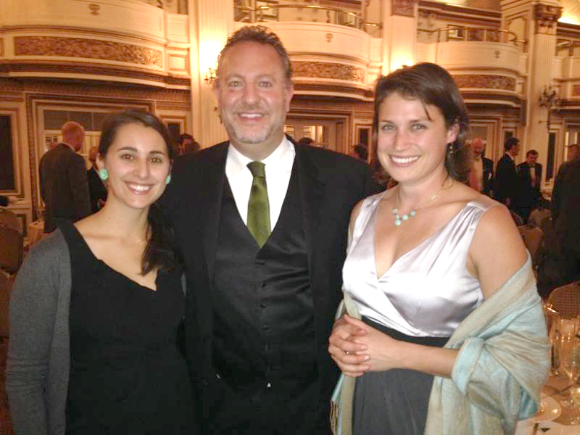
Maine Clean Energy Day in Augusta, March 2015
E2Tech Staff at 2014 NECEC Green Tie Gala in Boston
Front row: Brad Weller, Patrick Coughlin, Jim Atwell, John Ferland, and Tim Soley. Back row: Jim Katsiaficas, Bill Taylor, Claudette Townsend, David Ertz, Gary Higginbottom, Phil Coupe, and Bill Ferdinand. Not Pictured: Chad Allen, Brooke Barnes, John Carroll, Becky Metivier, Michael Stoddard, Elizabeth Swain, and Jeff Thaler.

Slide 8
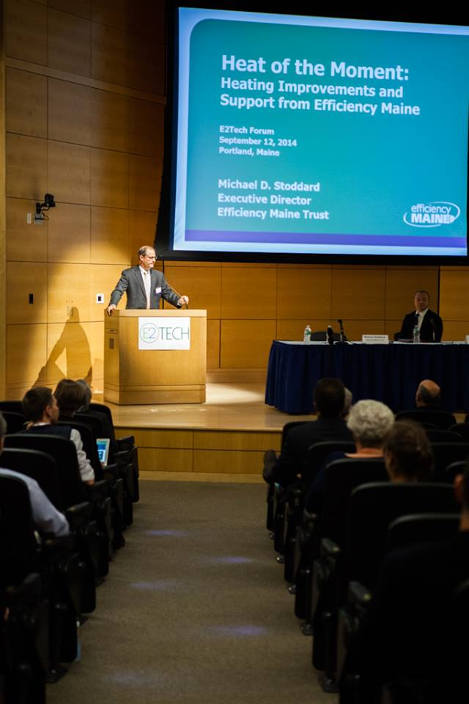
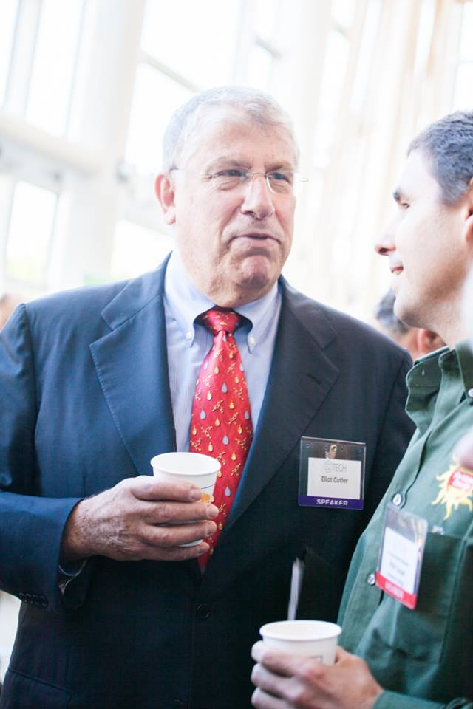
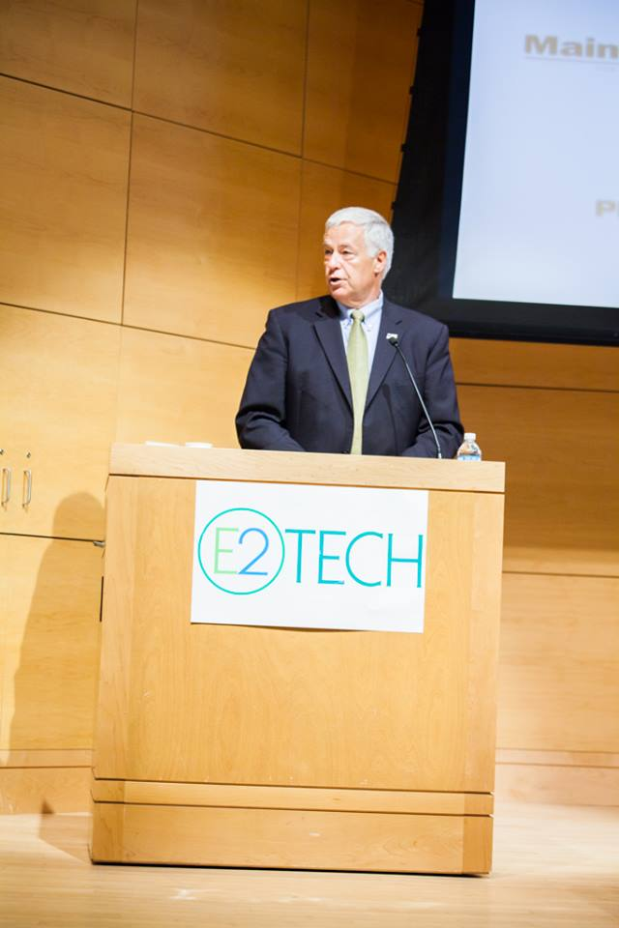
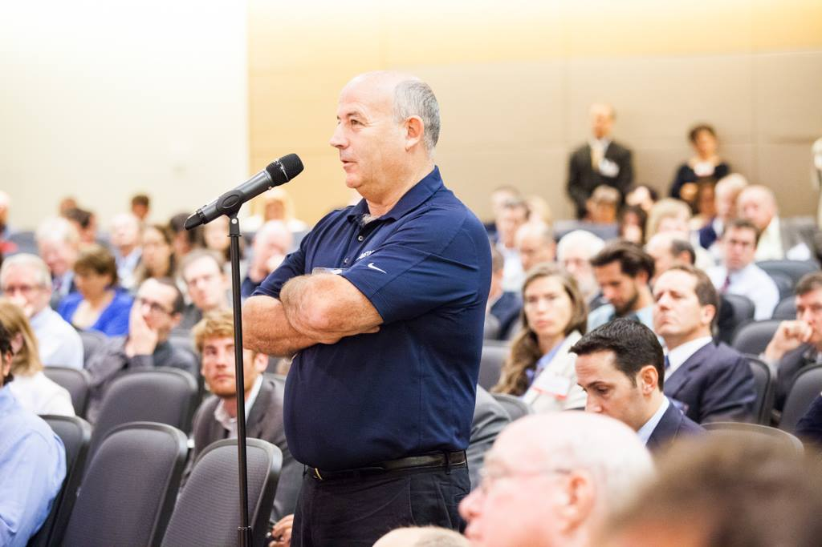
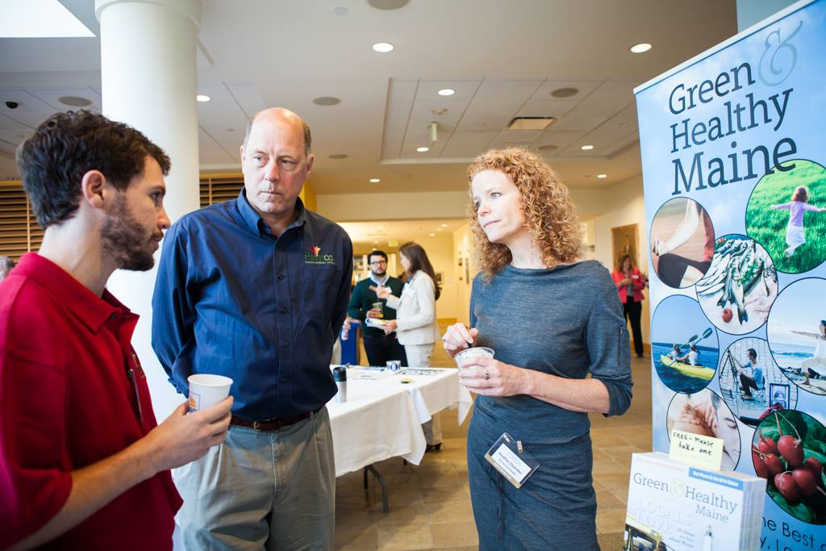
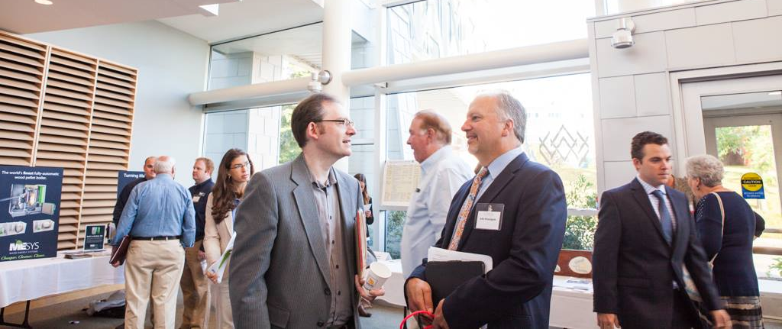
September 2014
Heat of the Moment

Slide 9
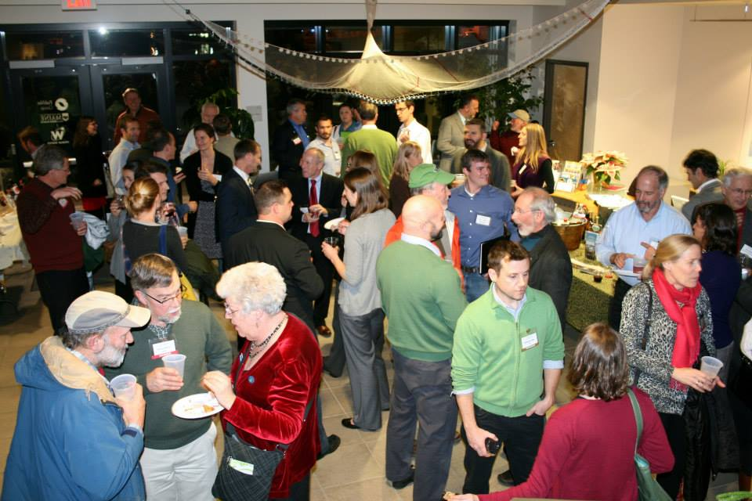
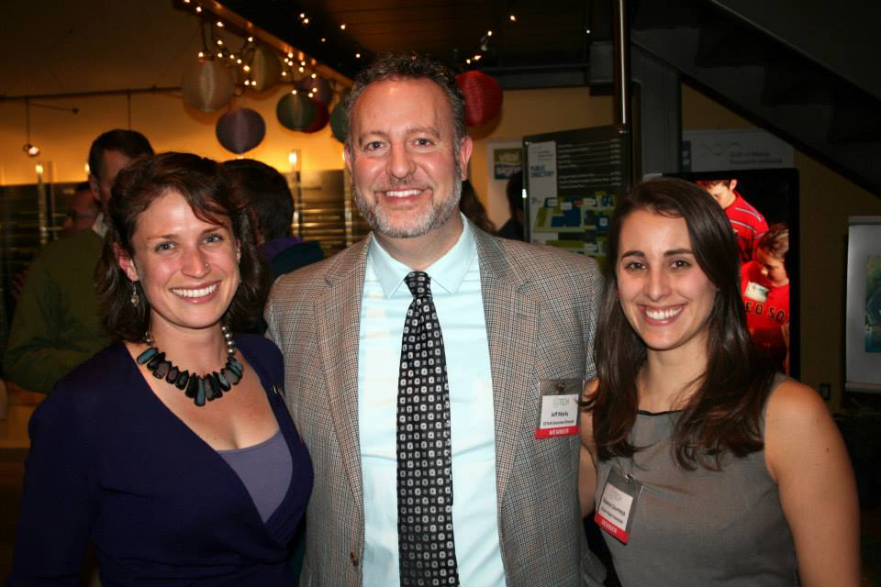
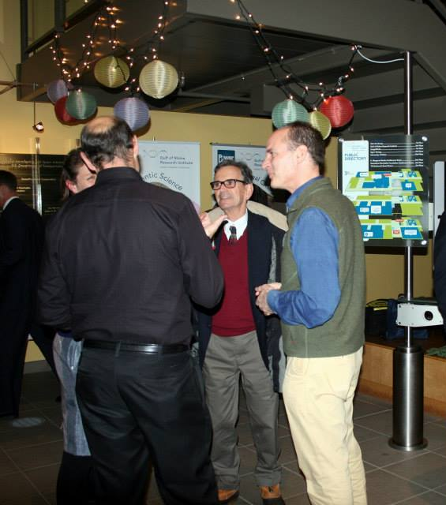
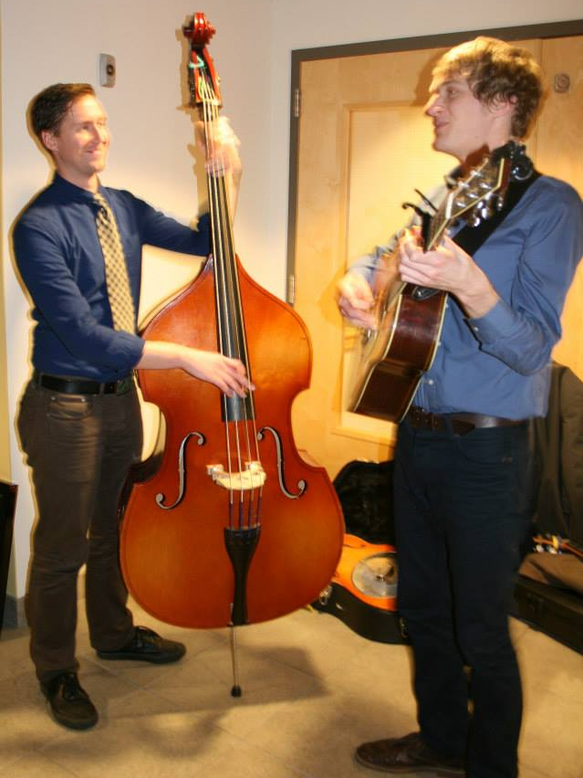
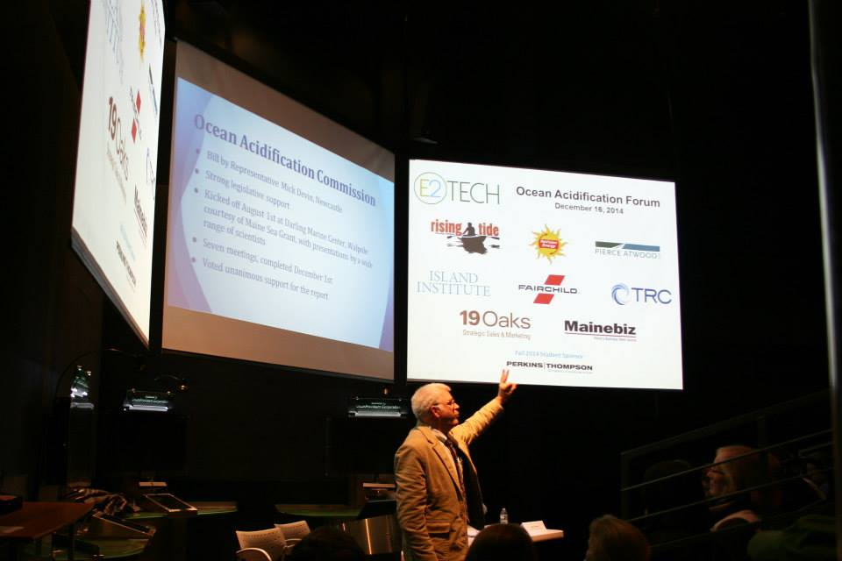
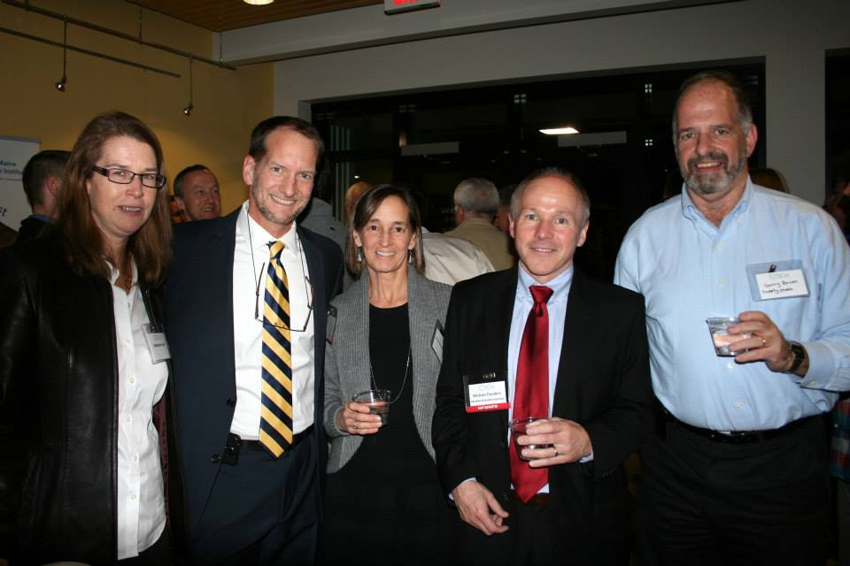
December 2014
Ocean Acidification & Holiday Networking Event at the Gulf of Maine Research Institute

Slide 10
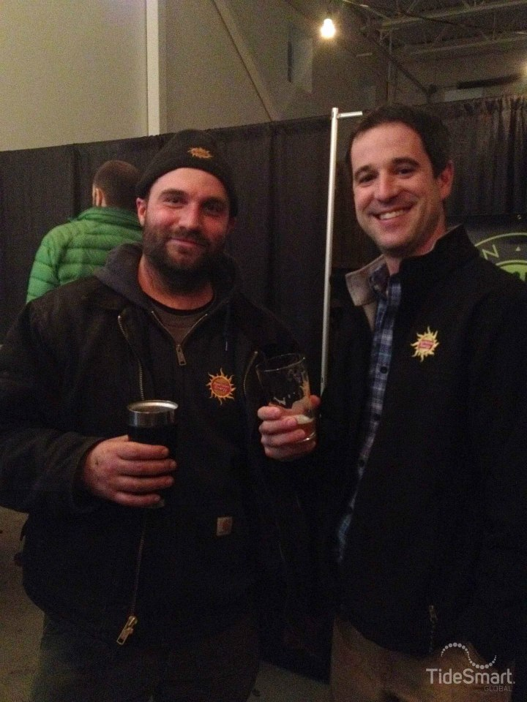
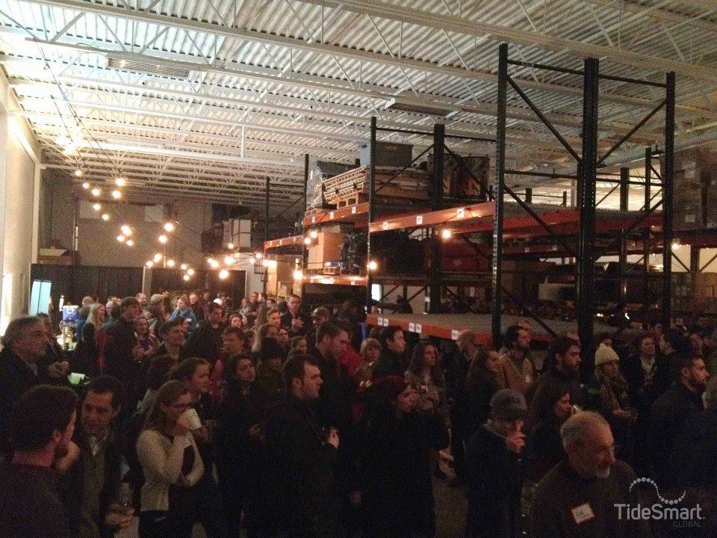
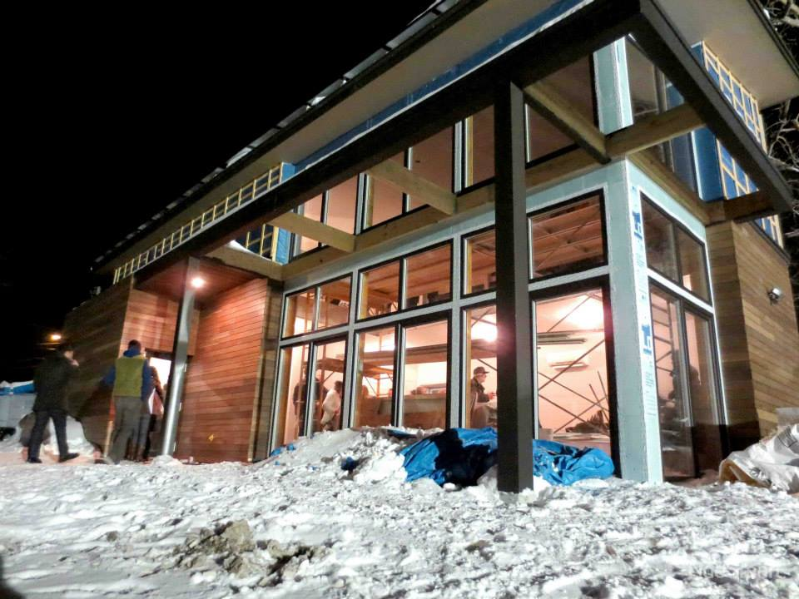
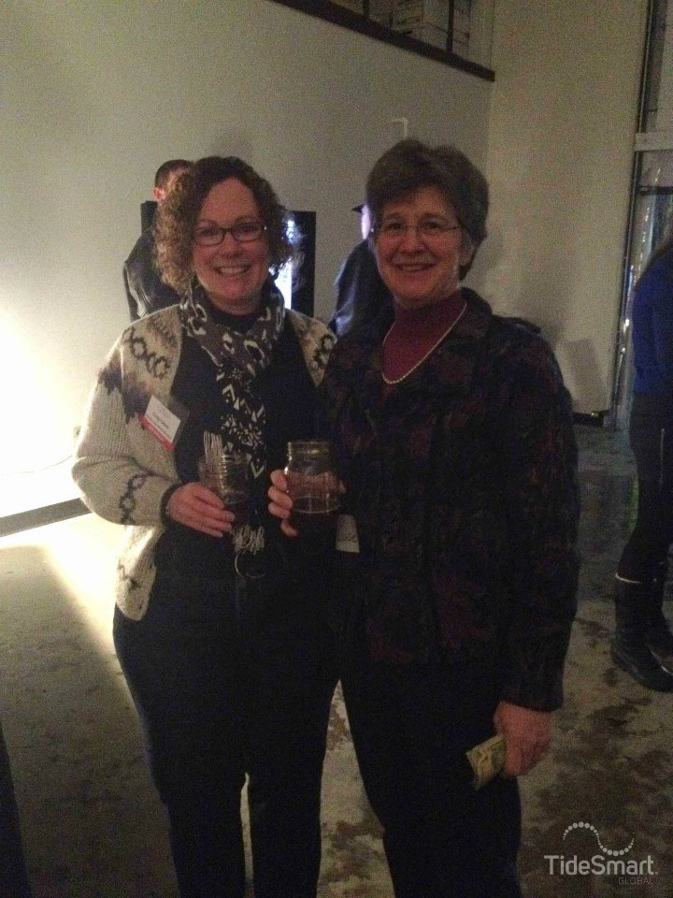
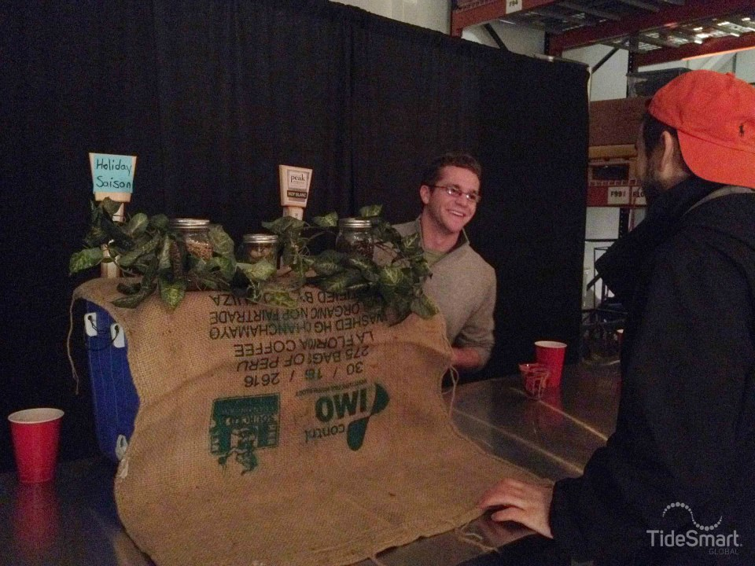
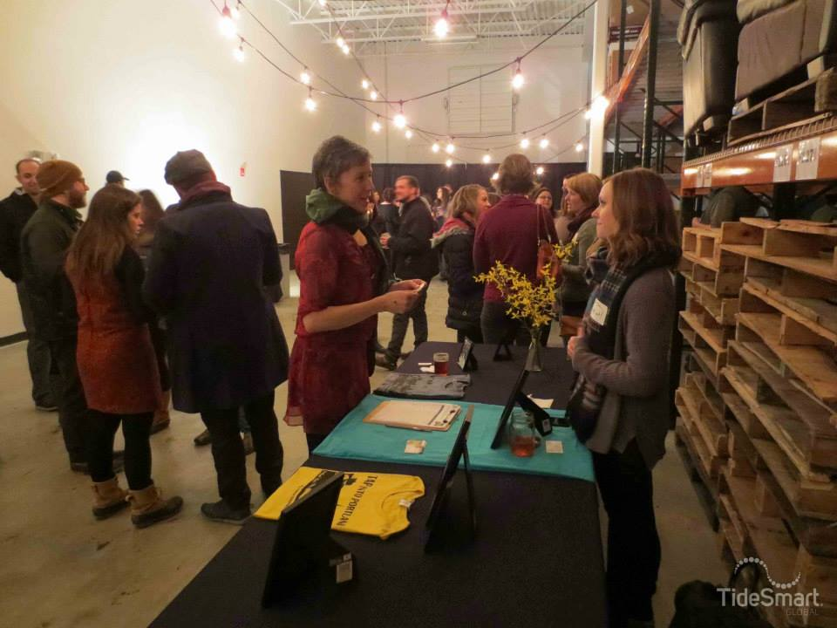
February 2015
Portland Greendrinks at TideSmart Global

Slide 11
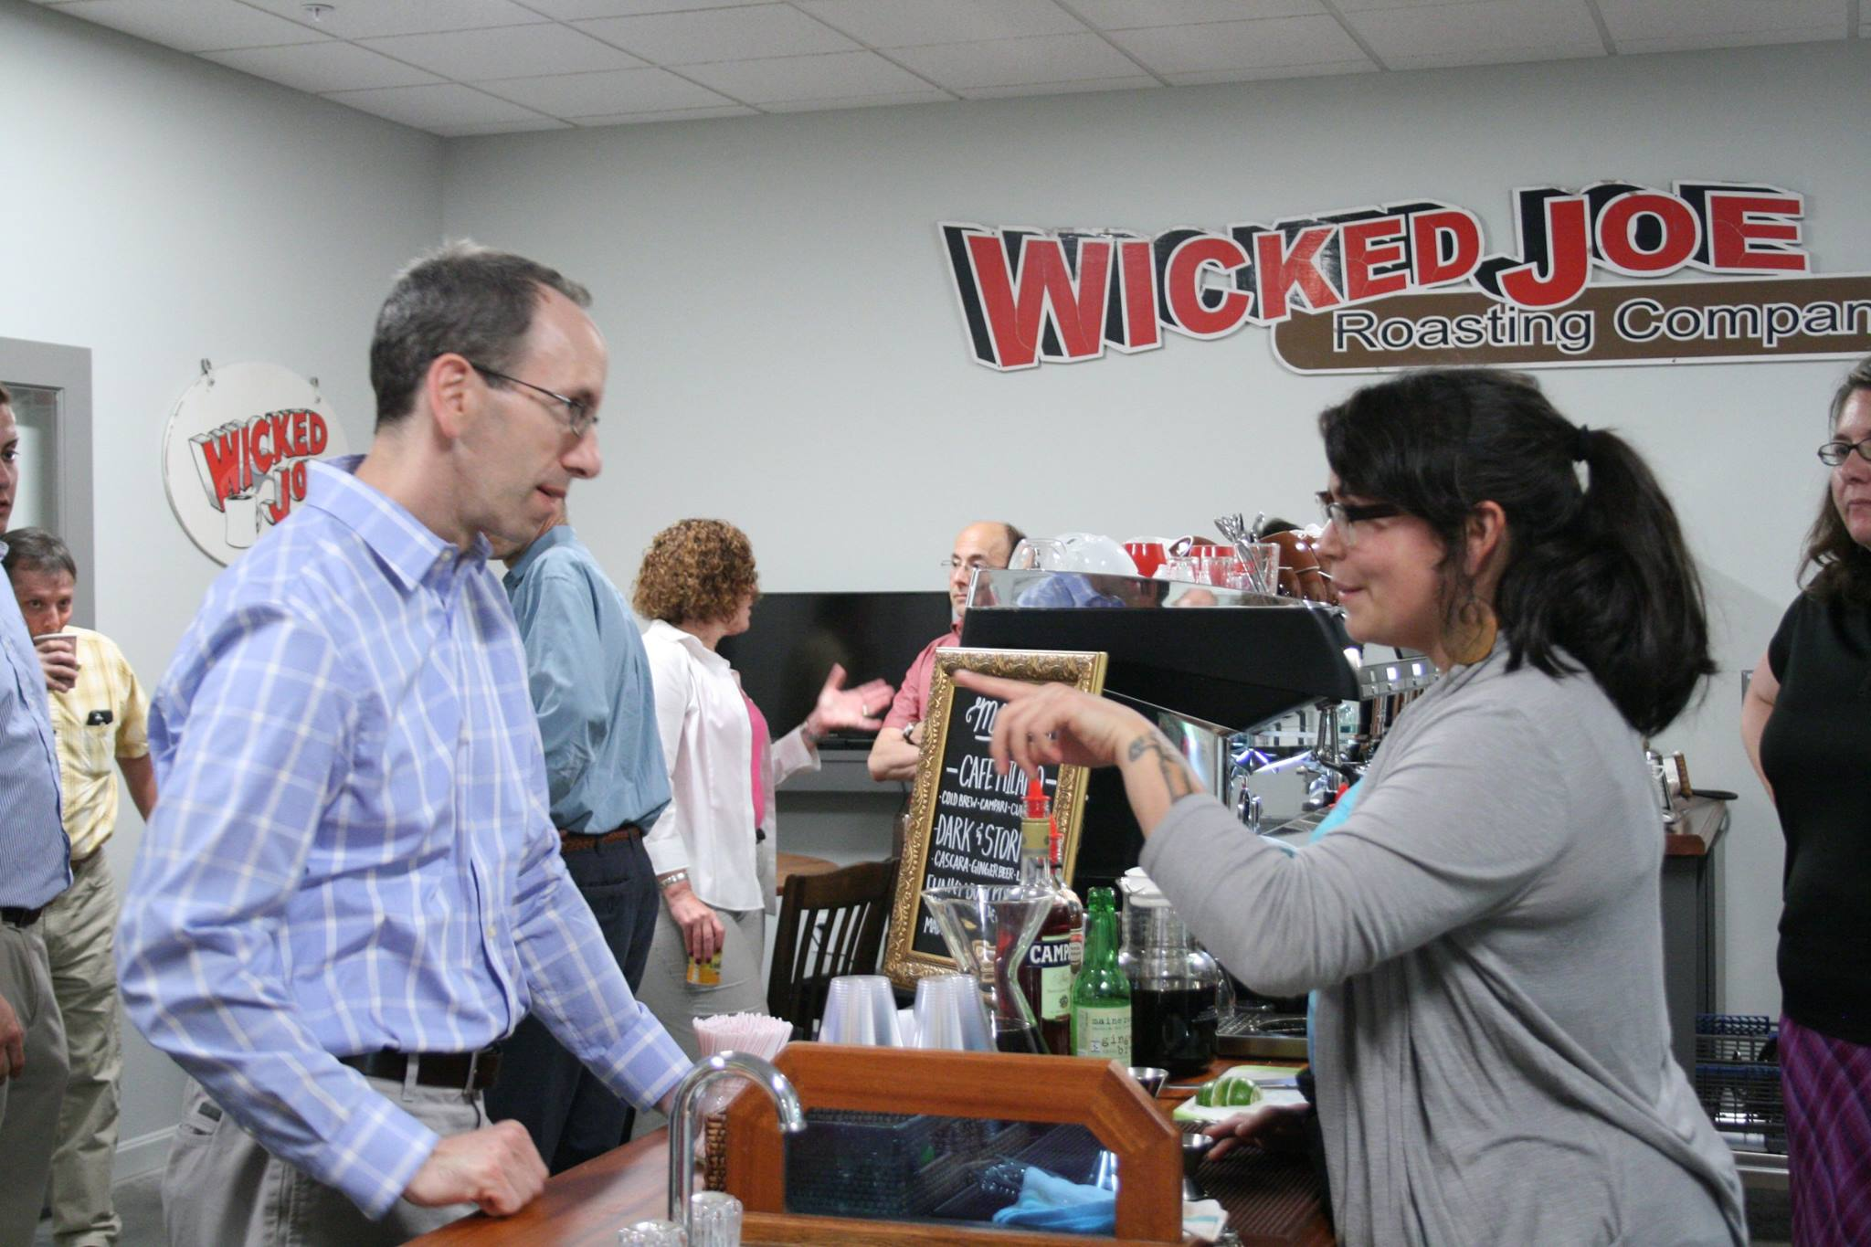
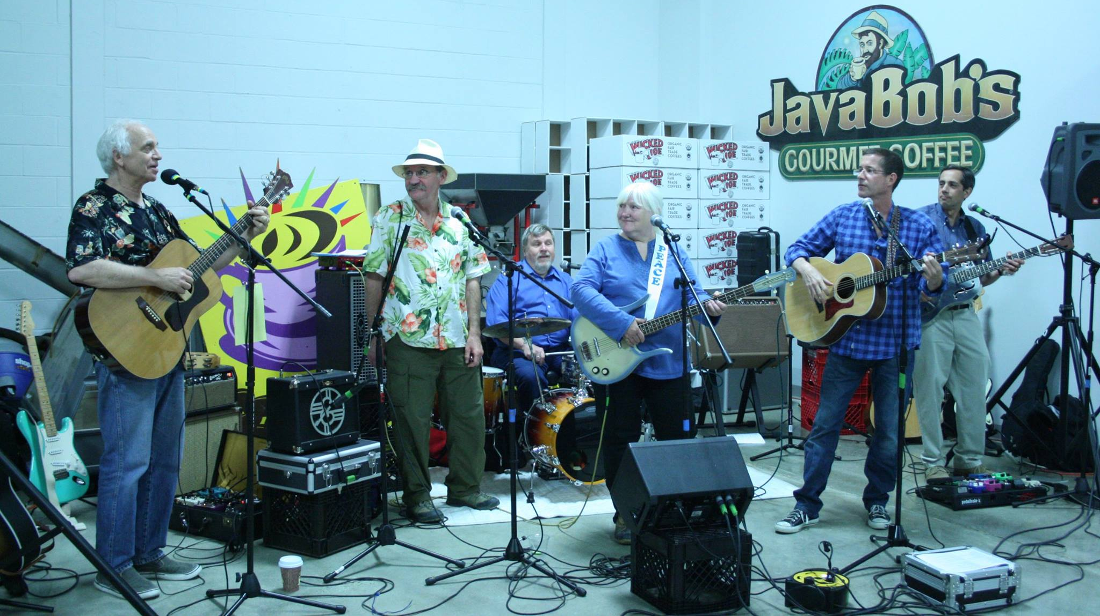
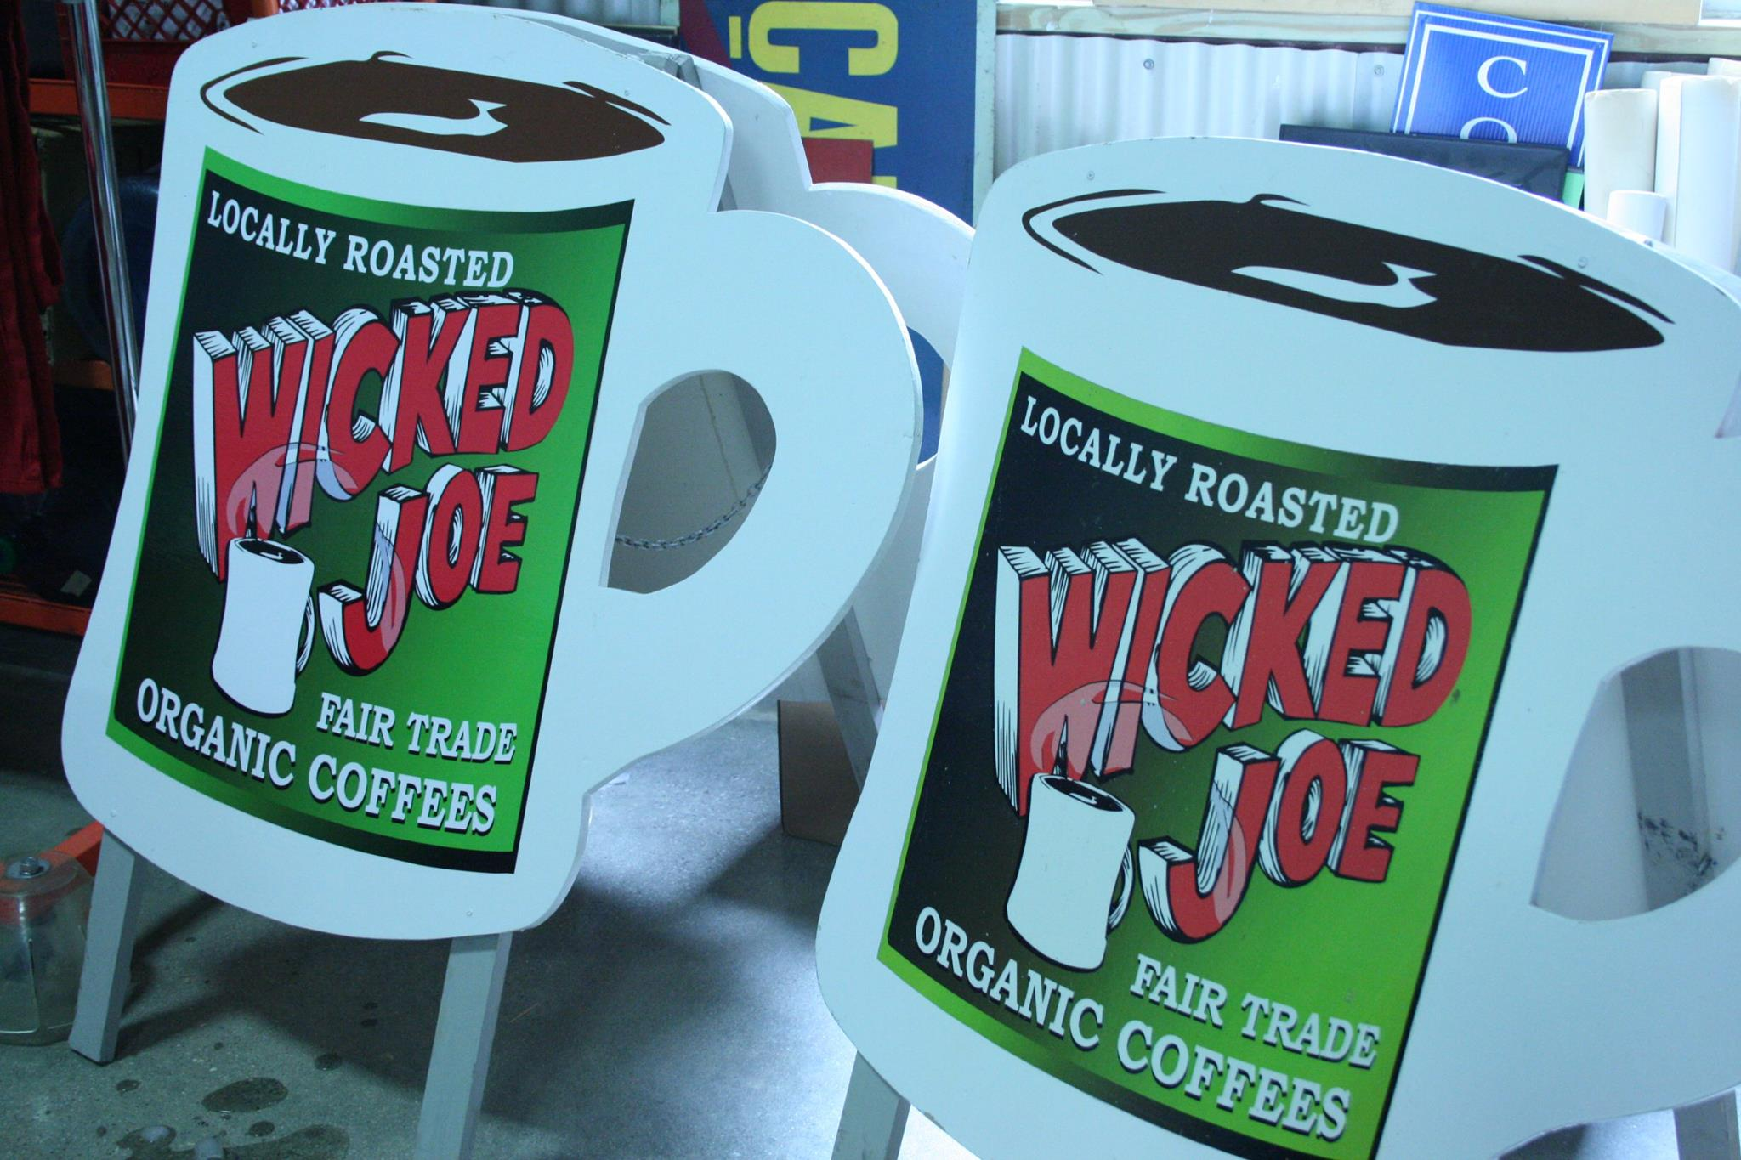
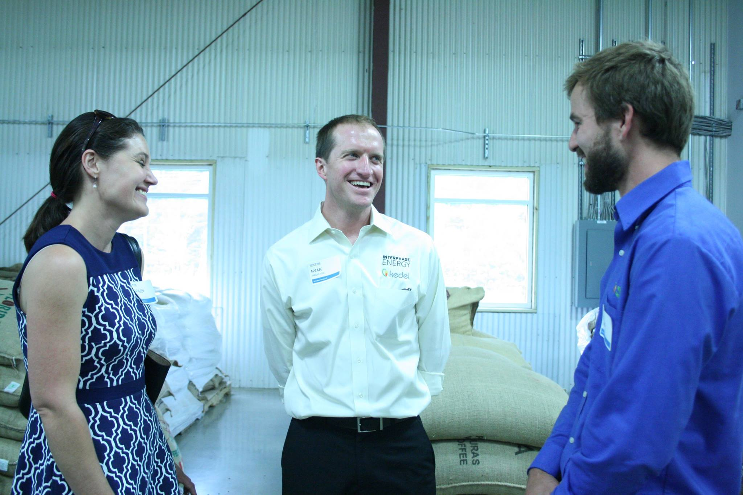
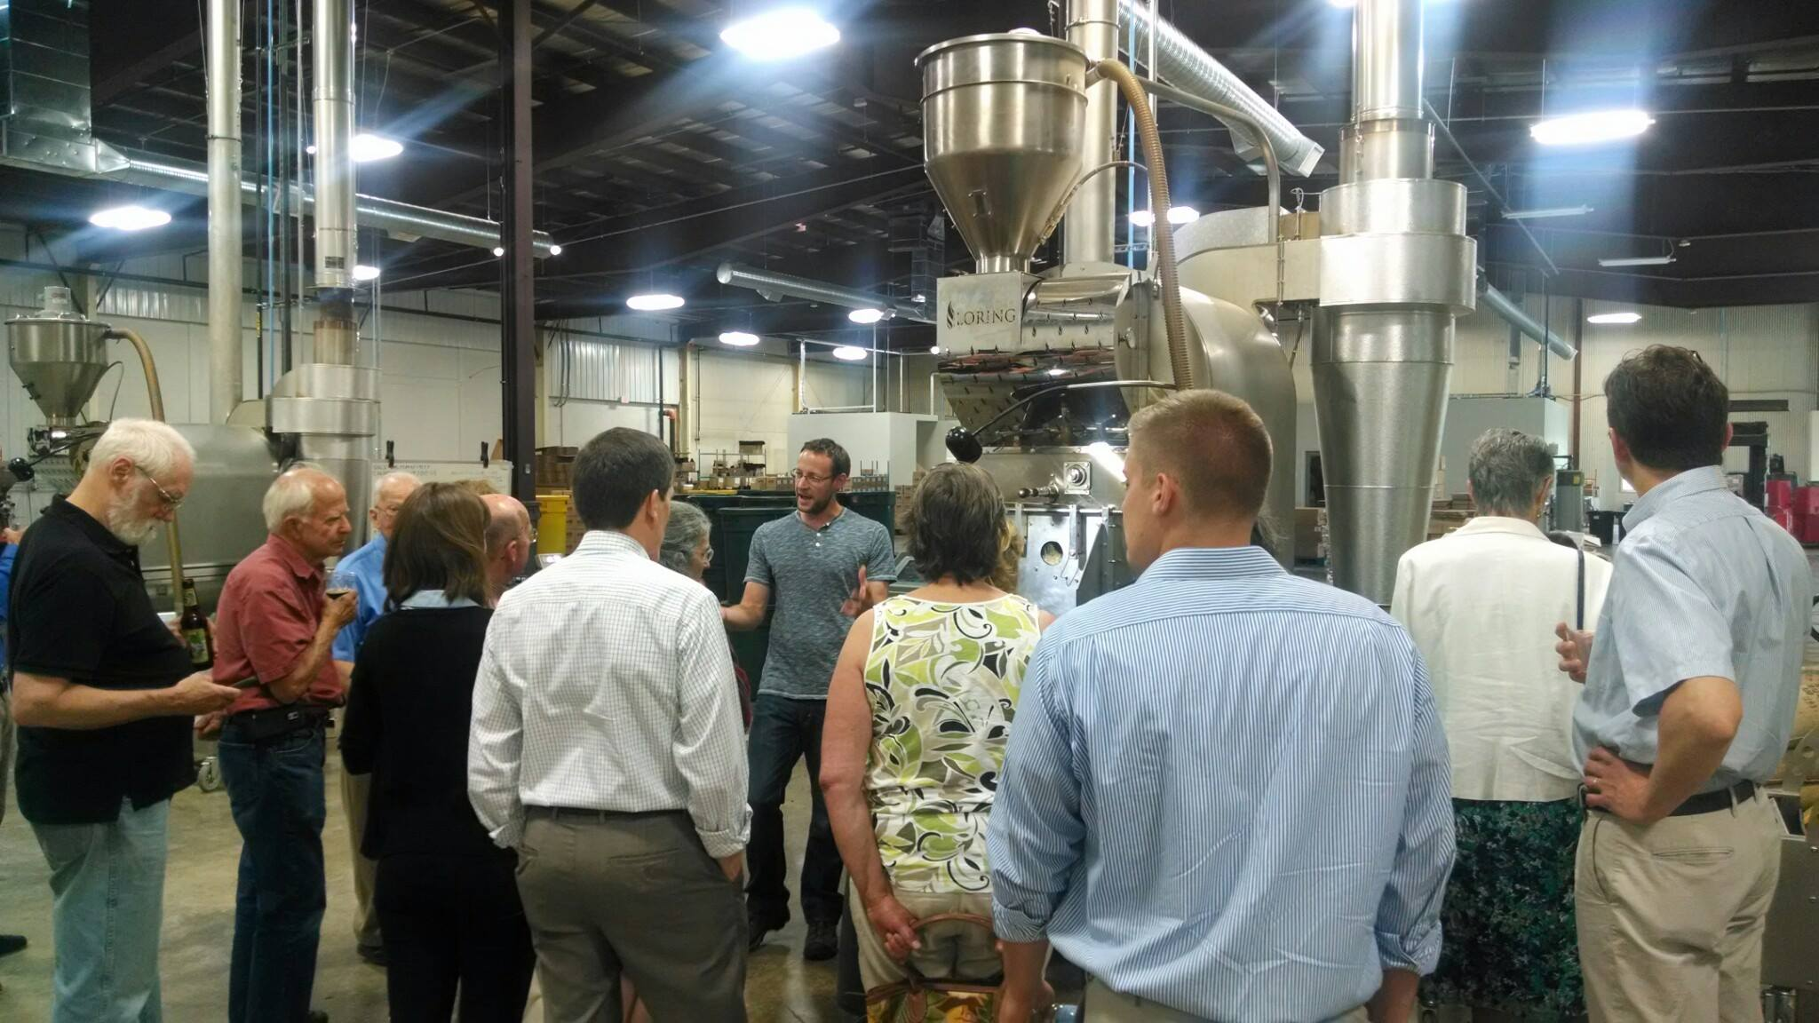
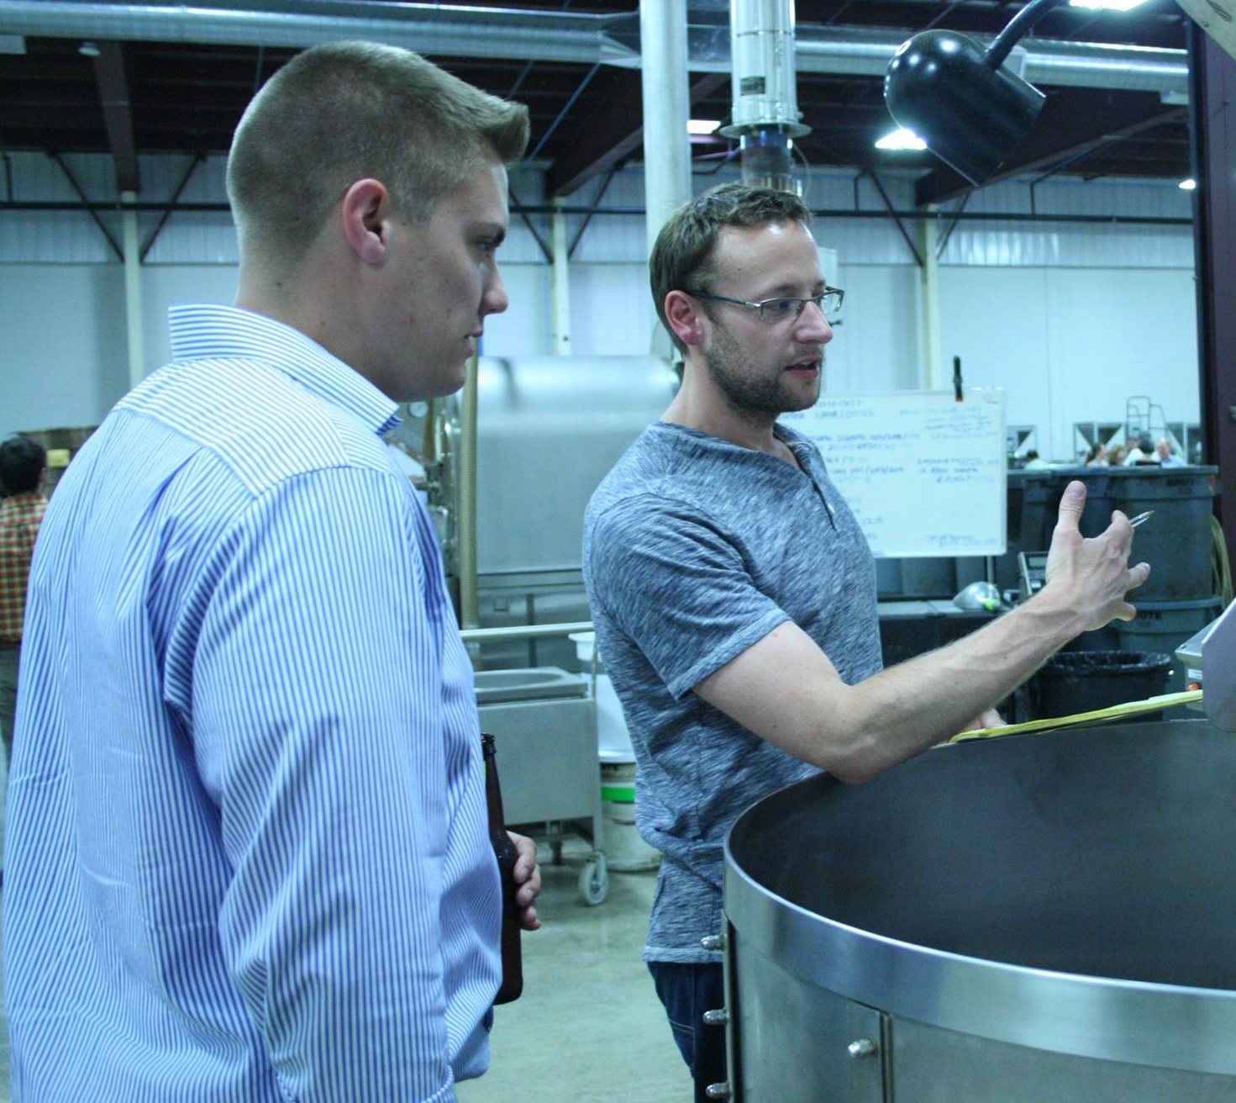
June 2015
Wicked Cool Networking Mixer at Wicked Joe Coffee

Slide 12
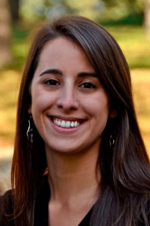
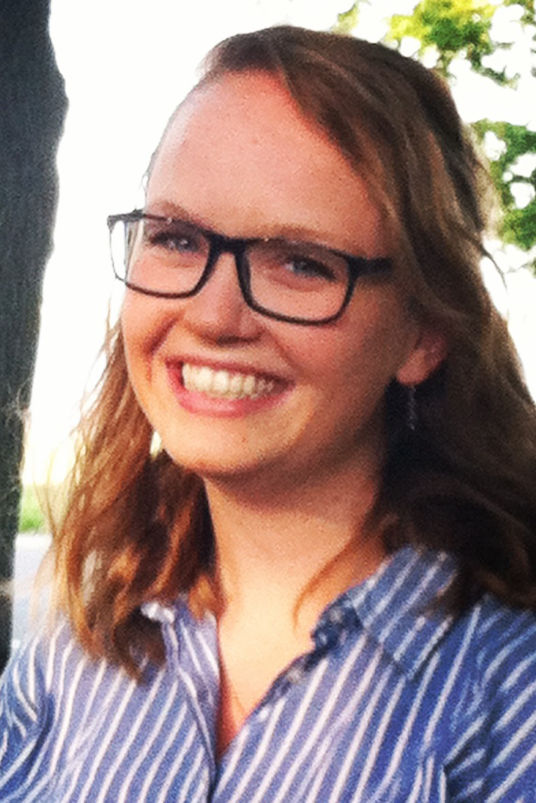
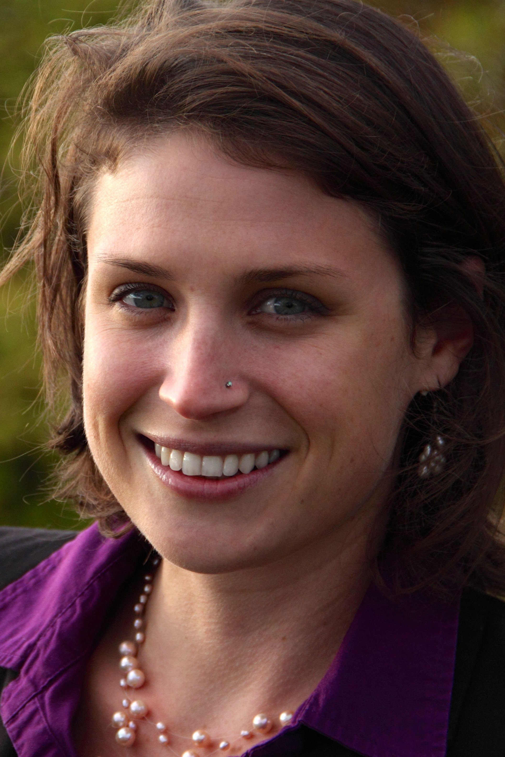
E2Tech Staff
Brianna Courneya
Graphic & Web Design Consultant
Jeff Marks
Executive Director
Melissa Winne
Project Associate
Cindy Talbot
Operations Director
Bonnie Frye Hemphill
Maine Innovation & Cleantech Connector

Slide 13
FY2015 Forums, Networking Events & Workshops
August 2014 | Summer Networking Event at Bigelow Laboratory for Ocean Sciences
September | Energy, Cleantech, & the Transatlantic Trade and Investment Partnership (TTIP)
September | Heat of the Moment: Plans from State Officials, Energy Companies, and Maine’s Next Governor
October | Organics & Residuals Separation and Processing in the Solid Waste Stream
November | E2Tech Annual Meeting- Extreme Makeover: Environmental Remediation
December | Innovation Engineering Workshop
December | Ocean Acidification & Holiday Networking Event at the Gulf of Maine Research Institute
January 2015 | Maine’s Energy Policy 2015
January | Worker Training & Internship Briefing

Slide 14
FY2015 Forums, Networking Events & Workshops
February | Portland Greendrinks at TideSmart Global
February | Hydropower: A Dam Good Forum
March | Cleantech Open 2015 launches in Maine
March | Renewable Energy Incentives: Investment or Entitlement?
April | “Current” Events in Stormwater
May | Biobased Maine: Advancing Biobased Manufacturing for a Sustainable Maine Economy
May | Branching Out: The Future of the Forestry Industry
June | Wicked Cool Networking Mixer at Wicked Joe Coffee
June | Energy Storage: Saving for a (Renewable) Rainy Day

Slide 15
Projects & Partners

Slide 16
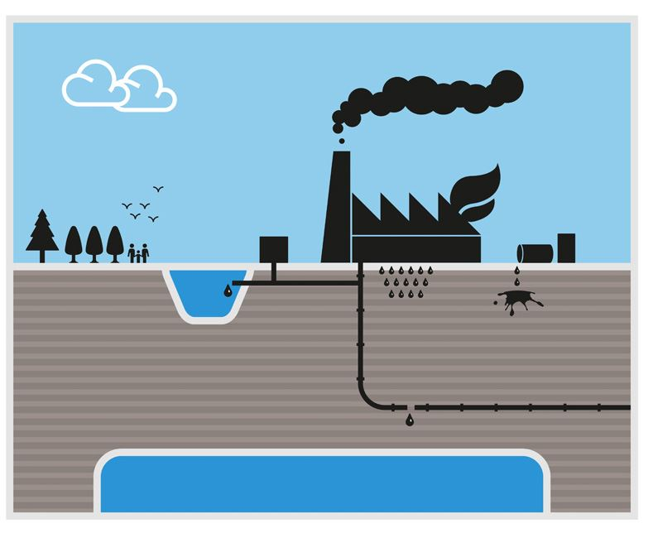
November: Annual Meeting & Forum-
Risky Business: Floods, Fatalities, and Fear

Slide 17
Save the date:
December 15: Aquaculture Forum and Winter Networking Event

Slide 18
What’s Ahead for 2016
State Energy Planning Roadmap
SBA Accelerator Fund
Energy & Environmental Supply Chain Database- LIVE!
Forums, seminars, and workshops
2nd Annual E2Tech Expo
National & International marketing opportunities

Slide 19
Department of Energy,
State Energy Planning Roadmap
E2Tech, with the Governor’s Energy Office, was awarded $284,000 in federal grant funding to develop an implementable, stakeholder-driven plan that lowers energy costs, improves the environment, and advances energy security.
The Roadmap will be developed in three distinct phases over a two-year period:
Phase I – Baselining
Phase II – Time Horizon and Regional Development Goals
Phase III – Action/ Implementation Plan/ Roadmap Development
The final product will be a comprehensive, actionable Maine Energy Planning Roadmap with significant input from private, public, and non-profit leaders throughout the national, regional, and state energy ecosystems and a clear implementation plan with strategies, participants, deliverables, recommendations, and milestones.

Slide 20
SBA Accelerator Fund
In August, E2Tech was awarded $50,000 from the Small Business Administration (SBA) Growth Accelerator Fund.
This funding assists E2Tech with the following projects:
Convening the “E2Tech Expo” in October, displaying the state of Maine’s energy, environmental, and cleantech sector;
Increasing Maine entrepreneurs’ access to the Northeast Clean Energy Council’s Navigate Northeast network and concierge services;
Studying the ripple effect of clean-energy development in expanding Maine’s manufacturing supply chains.

Slide 21
FY2015 Annual Report
Thank you for your continued support!

