Slide 1
Maine Wind Power Forum Why Wind Power in Maine ?
Colin High Resource Systems Group Inc. October 26, 2011

Slide 2
Why Wind Power in Maine?
The US must reduce its Greenhouse Gas Emissions by at least 80% by 2050 to avoid potentially catastrophic climate change.
This will require a dramatic reduction in the use of fossil fuels for all purposes.
And a rapid increase in the use of of near zero emissions energy sources to generate electricity in existing sectors.
And expanded use of near zero emissions electricity for vehicles.
Wind is an essential component of Maine and New England’s energy future because:
Wind has near zero air emissions and no significant hazards or waste disposal issues like nuclear power.
The cost of wind generated power on a per kWh basis is, or soon will be competitive with coal and gas.
Maine has a large potential for on shore and off shore wind but it will require a broad public consensus to speed up development.

Slide 3
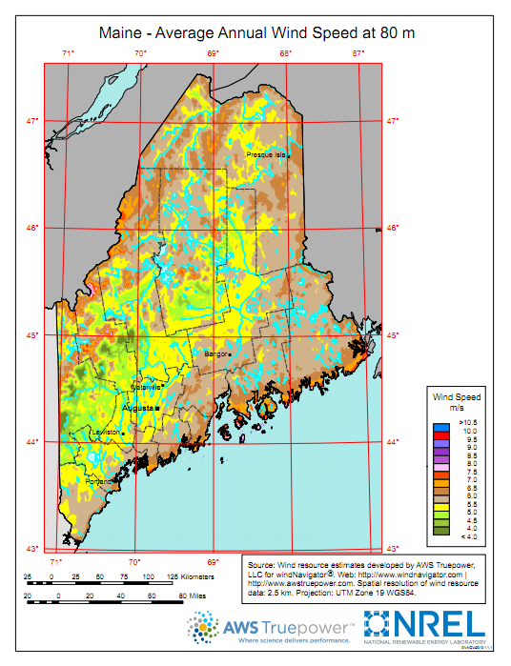
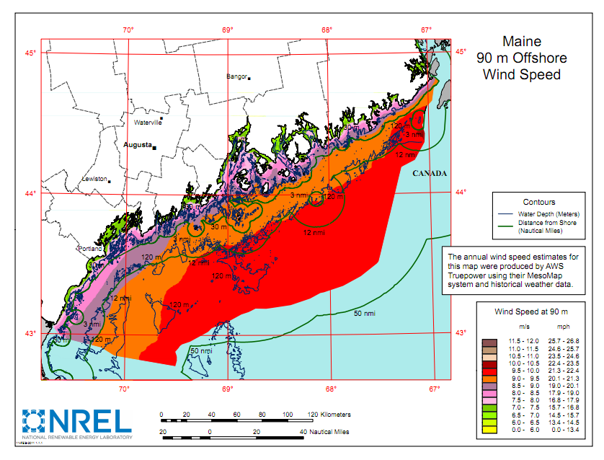
Maine Wind Map

Slide 4
Air Emission Benefits of Wind
Wind reduces air emissions in the following ways:
Wind directly displaces fossil fueled generation on the margin and reduces the need for additional fossil fueled capacity.
Wind therefore directly reduces emissions of GHGs -carbon dioxide, nitrous oxide, and methane and pollutants with direct health impacts such as nitrogen oxides, sulfur dioxide, fine particulate matter, mercury and volatile organic compounds.
Indirectly wind reduces upstream methane from the extraction of fuel at coal mines and oil and gas wells.

Slide 5
Avoided Emissions from a 40 MW Wind Farm in Maine
Avoided Generation by Fuel
Avoided Emissions
Fuel | MWh
Gas | 84,700
Oil | 11,462
Coal | 10,910
Biomass | 0
Other | 144
Annual | 107,216
Calculated by the RSG Time Matched Marginal (TMM) Model of the NE ISO (2007 data).

Slide 6
Conventional Analysis Underestimates Wind Benefits
The widely used conventional analysis based on EPA eGRID system average emission rates underestimates avoided emissions from wind power compared with time matched marginal emissions analysis that is consistent with the WRI Protocol.
Conventional analysis does not include indirect upstream air emissions

Slide 7
Other Considerations
Additional transmission capacity for wind will be needed in some cases, but wind is not expected to require additional back up gas generation until wind is 30% or more of the regional generation mix.
Wind can be predicted and incorporated into the NE ISO market bidding process.
Off shore wind power at present is more expensive to develop than land based wind farms.
Cost of all wind generation is expected to decrease in the future with experience and scale.

Slide 8
Conclusions
Wind is the best option for providing large amounts of near zero emission power in Maine in the next one or two decades at a cost comparable to fossil fuels.
Maine needs to build a broad consensus on the need for a substantial growth of wind power to avoid the delays and added costs that are often associated with misunderstandings about the impacts of large scale deployment of wind power.
At present wind is the most economical, environmental and morally responsible electric power choice that we can make in New England.

Slide 9
Contact Information
Colin High
Resources Systems Group Inc.
55 railroad Row
White River Junction VT, 05001
chigh@rsginc.com
802-295-4999

